Slide 1
Nine Months of Research Into Working From Home: Looking Back to Look Forward Findings from 40+ studies into remote work that are participating in the Future of Remote Work Initiative (http://aka.ms/forw) E+D Applied Research Talk Series (aka.ms/exdar-talks) Dec 2, 2020
Microsoft confidential. Please do not share externally.
Notes:
Microsoft is the world’s productivity company.
-The tools we build have enabled people and organizations to use technology to get things done better, faster, and more accurately.
-Recent technological breakthroughs in our tools’ ability to observe, learn from, and even influence human behavior
-Are fundamentally changing the relationship between technology and productivity.
-Creates a unique opportunity for Microsoft to reimagine the future of productivity.
Nine months ago we all experienced a significant disruption in work practices with COVID.
-That make it pressing that we capture this opportunity.
-People around the world moved to working from home to working remotely, and
-Microsoft products became essential getting anything done.
-Fortunately, as the world’s productivity company,
-We had a number of rich sensors already in place to understand this change and
-Help our customers and employees manage through it.
Today’s presentation will look at how work practices have changed post-COVID.
-Represents one of the largest cross-company research effort in Microsoft history.
-Synthesizes findings from every Microsoft division (including GitHub, LinkedIn).
-These findings are being used by product teams, sales, marketing, PR, HR, RE&S, and the OCEO
-To drive a research-backed response to changing work practices.
-I hope you enjoy the presentation, and find good ways to use these findings in your work as well.

Slide 2


Future of Remote Work Initiative: The Basics
E&D
Observational research
+
Solution-oriented research & product prototyping
Cloud & AI
>40 studies
MSR
CSEO
Our team also consists of:
People interested in conducting these studies
People interested in the outcome of these studies to inform product roadmaps + future research
Gaming
Notes:
Thank you Jaime.
[I’m Sonia Jaffe, a senior research economist and one of the initiative organizers.]
Before we delve into the research findings, I’m going share a few more details on the Future of Remote work initiative itself.
As Jaime alluded to, the initiative includes researchers on almost 50 studies from across Microsoft as well as people looking to learn from and build on the study findings.

Slide 3
Research studies
Affective Spotlight (Prasanth Murali, Javier Hernandez, Daniel McDuff, Mary Czerwinski, Kael Rowan) MSR AI
Business Continuity Dashboard (Andrew Leach) Workplace Intelligence
Compass customers/WFH survey (Caolan Mannion) Customer-Driven
COSINE Productivity during WFH (Brian Houck) COSINE (Windows)
Covid-19 Impact to IT Admins (Alaina Talboy, Matt Brodsky) Browser User Research, E&D
Covid-19 Impact to IT Admins – Returning to the Office (Alaina Talboy, Matt Brodsky) Browser User Research, E&D
COVID-19 Impact to IWs Research Series: Work Life Balance Difficulties (Alaina Talboy, Paula Bach) E&D Design + UX Research (Browser User Research Team)
CSEO WFH Study (Emily Peloquin, Sheri Panabaker, Emily Downing, Hope Idaewor, Patty Clusserath, Nalini Lyer)
CSEO Studio Decision-makers study (Erin Acuri, Adam Coleman, Brandon Haist, Hugh North, Shelly Marston, and Tiffany Smith)
Collective Planning & Research (XC P&R)
Detecting 'Working Remotely' ( Jeffrey Weston, Ijaz Ahmed, Shilpi Sinha, Longqi Yang, Romain Rey) IDEAs
Device Accessory Needs when WFH (Shuling Chen, Eric Lovelin) PCA/MACH
Devices + remote work study (Ginger Hudson, Steven Derhammer) Devices Research (E&D)
E&D Engineering Systems Health (Gurkaran Singh, David Spiers) OXO
ENVSN "A Good Day" Research - Attention, focus & flow in modern workplace (pre & during Covid19) (Harald Becker and Ming-Li Chai ) Envisioning Team
EPIC Employee Global Experience (Marcus Ash, Charles Yiu, Sean Oh) EPIC
Future of Workplace Paradigm Shift (Matthew Ayres) RE&S Center of Innovation
Future Workforce Study (Matthew Ayres) RE&S Center of Innovation
GitHub study of developer productivity (Nicole Forsgren, Taylor Holland, Gregory Ceccarelli, Anna Filippova) GitHub
Health, Well-being and Productivity During COVID-19: A Study of Boundaries and Adaptation (Mary Czerwinski, Shamsi Iqbal, Daniel McDuff, Jina Suh and the HUE team) MSR
Notes:
These many, many studies use a variety of methods

Slide 4
Research studies (continued)
Home|Work Blog (Natalie Singer-Velush) Workplace Intelligence
Impact of COVID-19 crisis on the future of work in India (Prerrna P. Kapoor, Abhijit Bairagi, Anita Isola) E+D India
Impact of the COVID-19 Pandemic on Remote Work Practices of Neurodiverse Professionals (John Tang, Maitraye Das) MSR
Job Seeking during COVID-19 (Chloe Stromberg) LinkedIn CMR
Leveraging Individual Differences to Improve Remote Work Outcomes (Longqi Yang, CJ Lee, Brent Hecht, Shilpi Sinha, Connor Joyce, Kevin Sherman, Neha Shah, Sonia Jaffe, Sid Suri, Jaime Teevan) E+D Office of Applied Research, IDEAs, WPI, Office of the Chief Economist
Lightweight survey of WFH learnings (Muiris Woulfe) Office Modernization Experiences (OMEX) team located in Dublin, Ireland
LinkedIn - Project Moxie (Hana Wolf, Leslie Forman, Sunny Patel, Anton Zadorozhnyy, Lindsay Kelly, Amulya Aradhyula) LinkedIn UER
Microsoft Pre-Opening Planning Survey HRBI
Mobile Info Worker and Remote Worker Archetype & Jobs to Be Done (Tom Glanz, Ashley Ferguson, Jake Rhodes) Windows Experiences UR
MSR Eng + PM WFH Survey (Web view) (Tom Zimmermann, Christian Bird, Denae Ford, Peggy Storey, Brian Houck, Jenna Butler, Sonia Jaffe) MSR Redmond, 1ES, COSINE, OXO, Office of the Chief Economist
Nudge study (Productivity Trends during COVID-19) (Chandra Maddila, Nachi Nagappan) MSR
OXO WFH Study (Jenna Butler) OXO
Project One Click and Blank Slate (Jera Nyman, Lia Kendall, Alexandra Lee) Business Applications Group
Project Sanctuary (Hadjar Homaei) Windows Experiences
Notes:
These many, many studies use a variety of methods

Slide 5
Research studies (continued)
Project Tahiti (Sean Rintel, Abi Sellen, Nancy Baym, Rachel Bergman. Thanks to Priscilla Wong & Emily Peloquin) MSR
Reflect Emotional Check-Ins (Kristi Kelly, Darren Austin) Reflect Team
Remote Work EEG Research (Steven Dong, Michael Bohan) Human Factors Engineering
Remote Work in ARD (China) (Yun Wang, Weiwei Cui, Haidong Zhang, Dongmei Zhang ) MSR Asia
Remote Worker Day in the Life Qualitative Interviews (Tom Glanz, Jake Rhodes, Jen Haard) Windows Experiences UR
SMB Freelance study (Siddharth Suri, Kelli McGee, Liane Scult, Sean Rintel) MSR, Marvel
Study of Impact on Information Worker Productivity (Meghan Stockdale, Therese Okraku, Megan Brown, Jamie Miller, Bella Chiu, Shelly Marston) eXperience Collective Planning & Research (XC P&R)
SwiftKey – mobile app usage (Charlie Edmunds, Jamie Olsen) MMX
Teams Meeting Effectiveness and Data Collection Study (Mary Czerwinski, Daniel McDuff, Samiha Samrose, Rob Sim, Jina Suh, Kael Rowan, Sean Rintel) MSR
Telework by people with disabilities (John Tang) MSR
The Effects of COVID-19 Crisis on Commercial IT Admins: Phase I (Matthew Brodsky) E&D Design + UX Research
Understanding BDMs (Kristina Perkins, Belinda Cheng and Greenberg (research consultancy)) CMR
Work trend index (M365 Marketing) M365 Marketing
“How Was Your Weekend?” Software Development Teams Working From Home During COVID-19 (Courtney Miller, Paige Rodeghero, Margaret-Anne Storey, Denae Ford, and Thomas Zimmermann) MSR Redmond, 1ES, COSINE, OXO, Office of the Chief Economist
ITDM in Commercial (Ginger Hudson) Devices Research (E&D)
Notes:
These many, many studies use a variety of methods

Slide 6
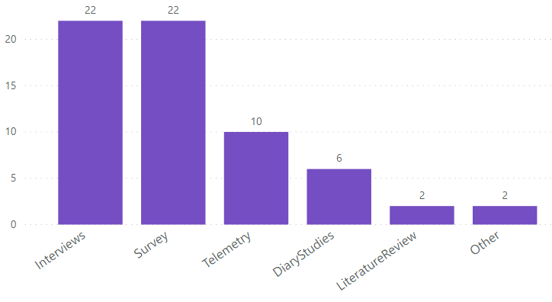
Research overview: diverse methodologies
Quantitative and qualitative methods
(many studies are mixed methods)
Notes:
These many, many studies use a variety of methods, both qualitative and quantitative. Interviews, surveys, longer term diary studies, as well as analyses of telemetry data from MSFT products.

Slide 7
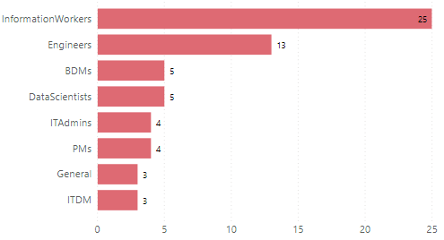
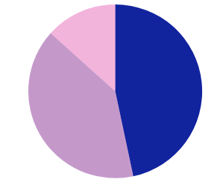
Research overview: diverse populations
External population vs. internal population
Population
(many studies look at multiple populations)
Both
6
External
21
Internal
18
Notes:
Some studies focus on MSFT employees, while others look at our customers, or other external populations. Many of them look at engineers and other information workers, but others study data scientists, IT admins, other decision makers, and the general population.

Slide 8
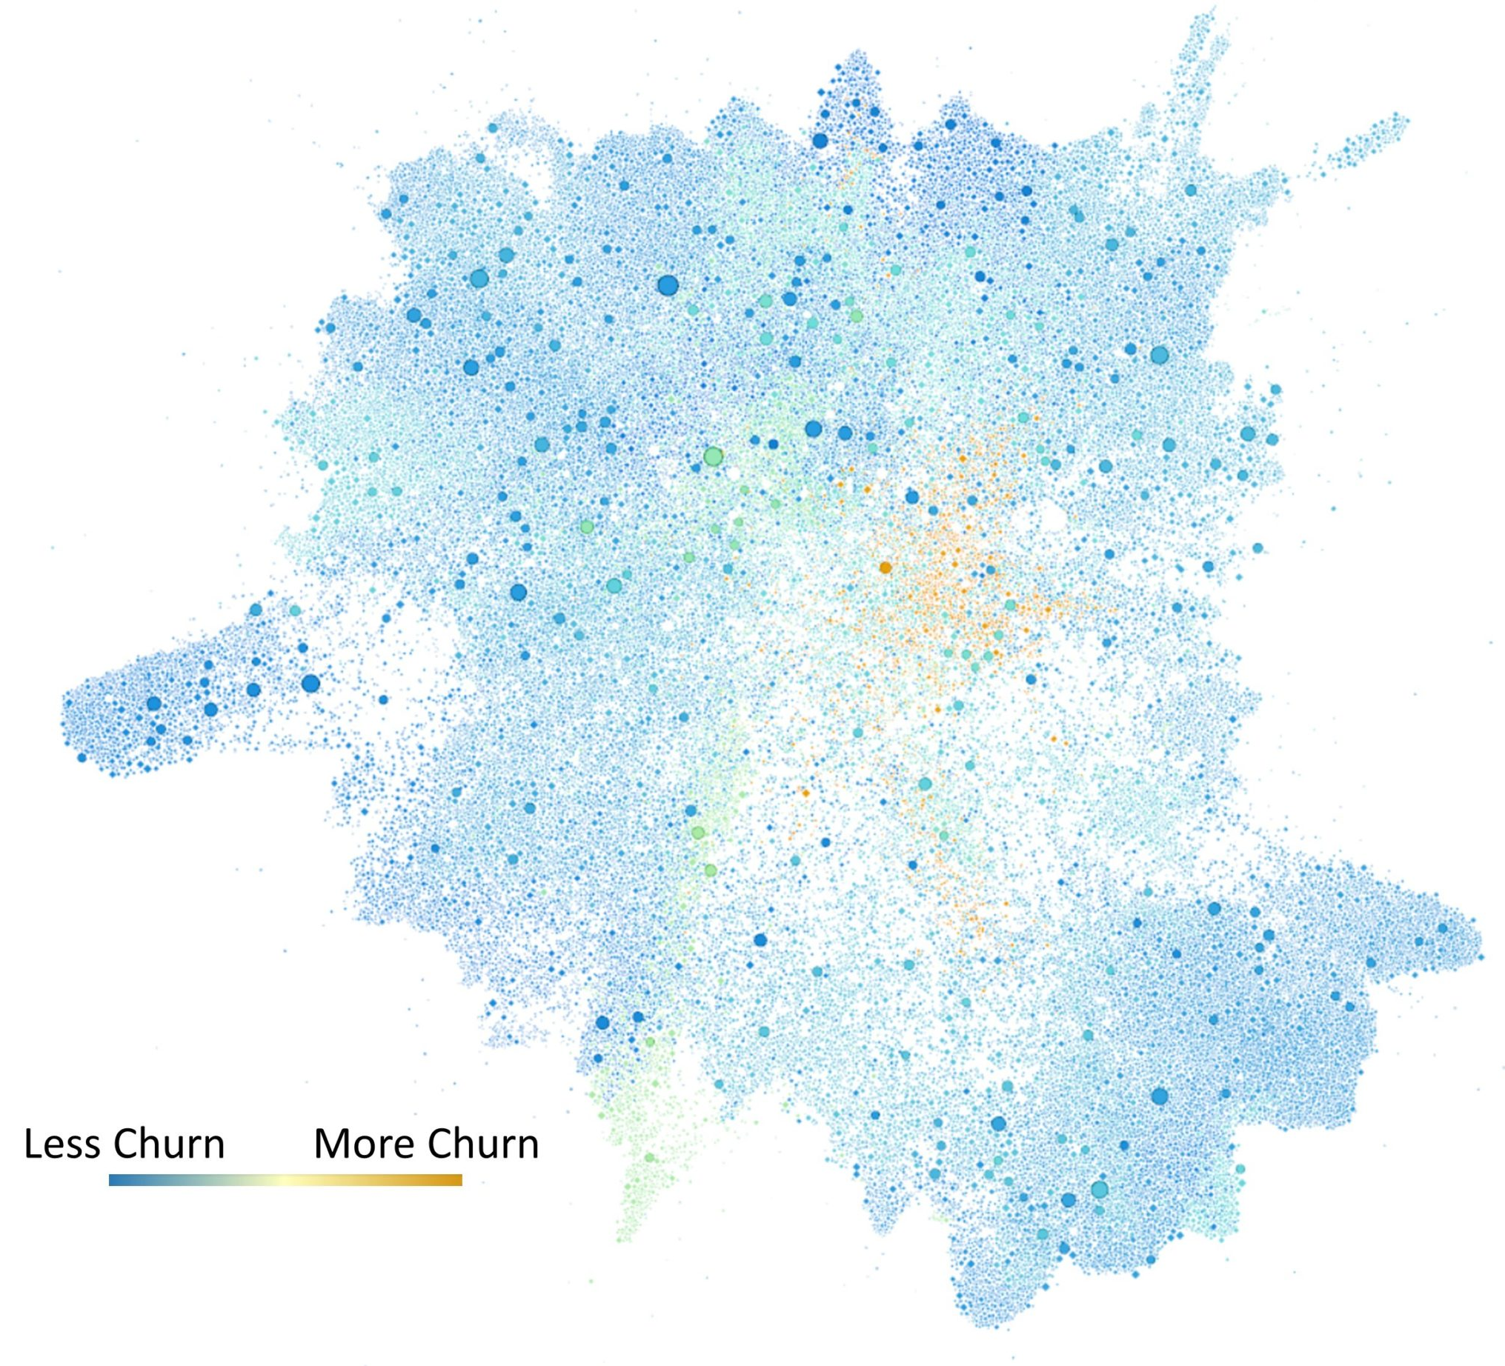
This research is enabled by unique Microsoft assets
Microsoft has a strong competitive advantage in understanding remote work
30 years of remote work expertise at MSR (aka.ms/forw-msr-blogpost)
Data, for example:
Data from the Microsoft Graph
IDEAs, Workplace Analytics
Developer data
GitHub, CloudMine
Customer platforms
Intercept, Compass
Source: Neha Shah, Jonathan Larson, Kevin Sherman, Natalie Singer-Velush. “Uncovering resilience: Measuring organizational networks during crisis”. Home|Work blog. Microsoft 365 Insights.
Notes:
As Jaime mentioned, Microsoft is well-positioned to conduct this research. In addition to the 30yrs of remote work expertise of MSR, we have data – telemetry from IDEAs and WPA as well as Github and various customer platforms.

Slide 9
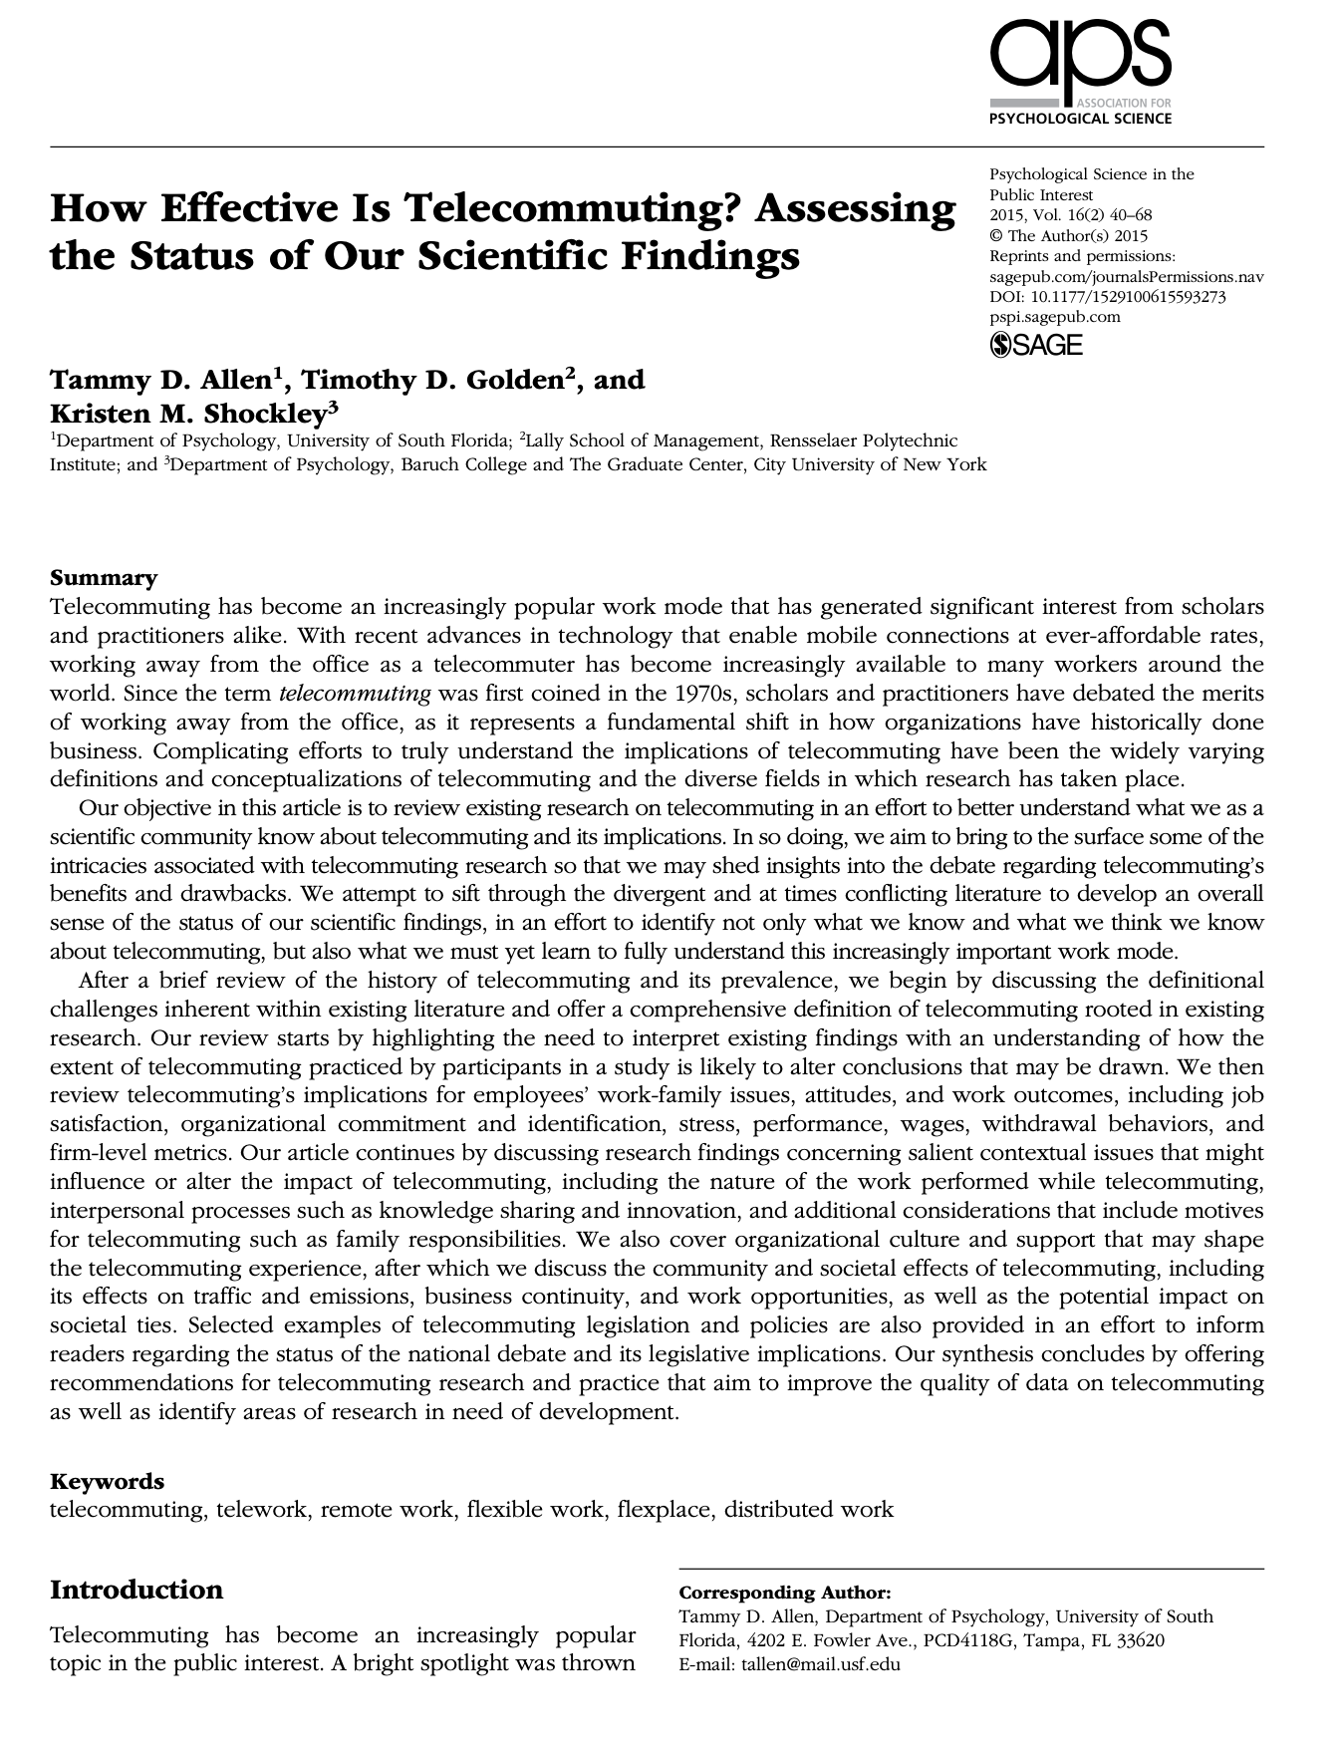
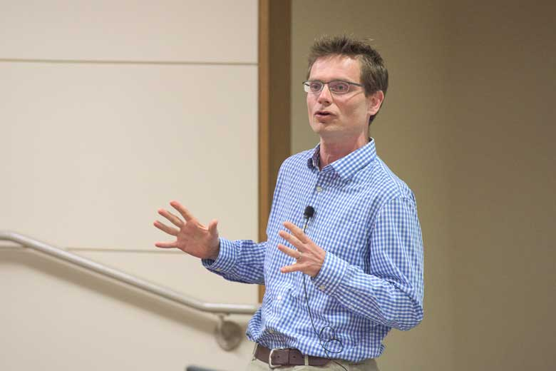
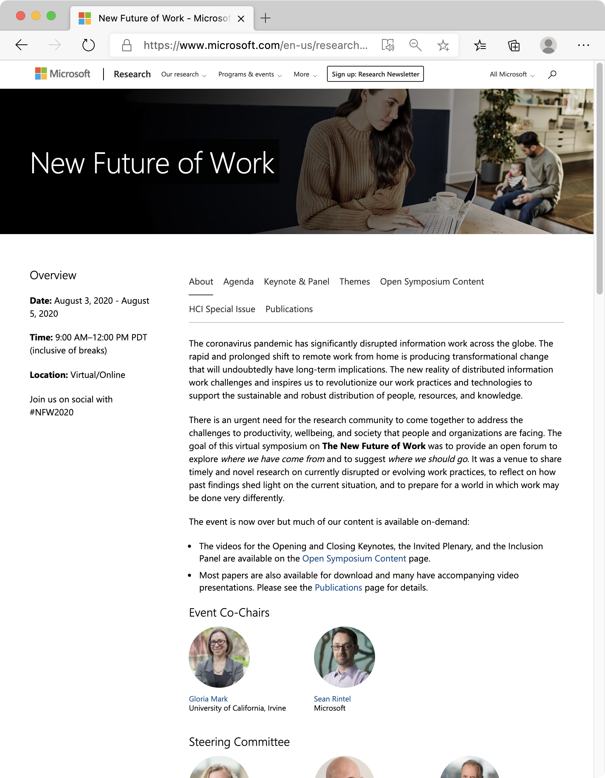
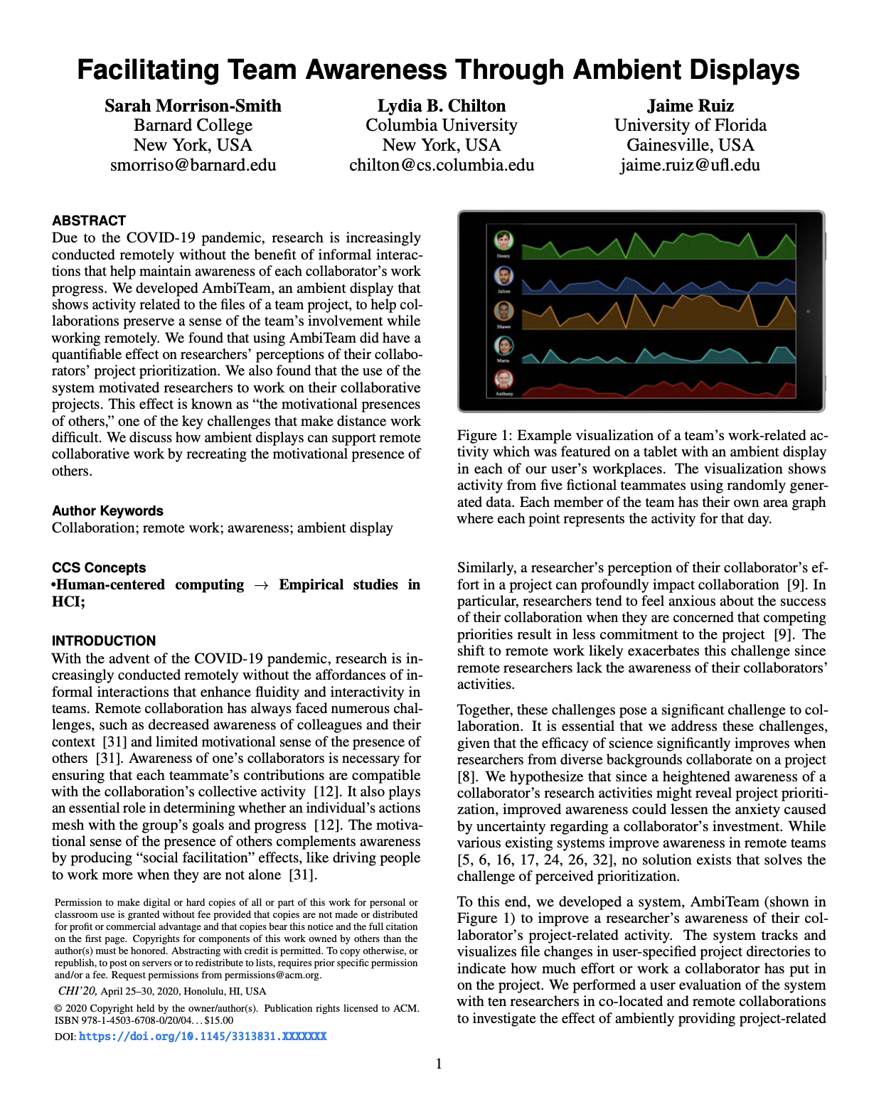
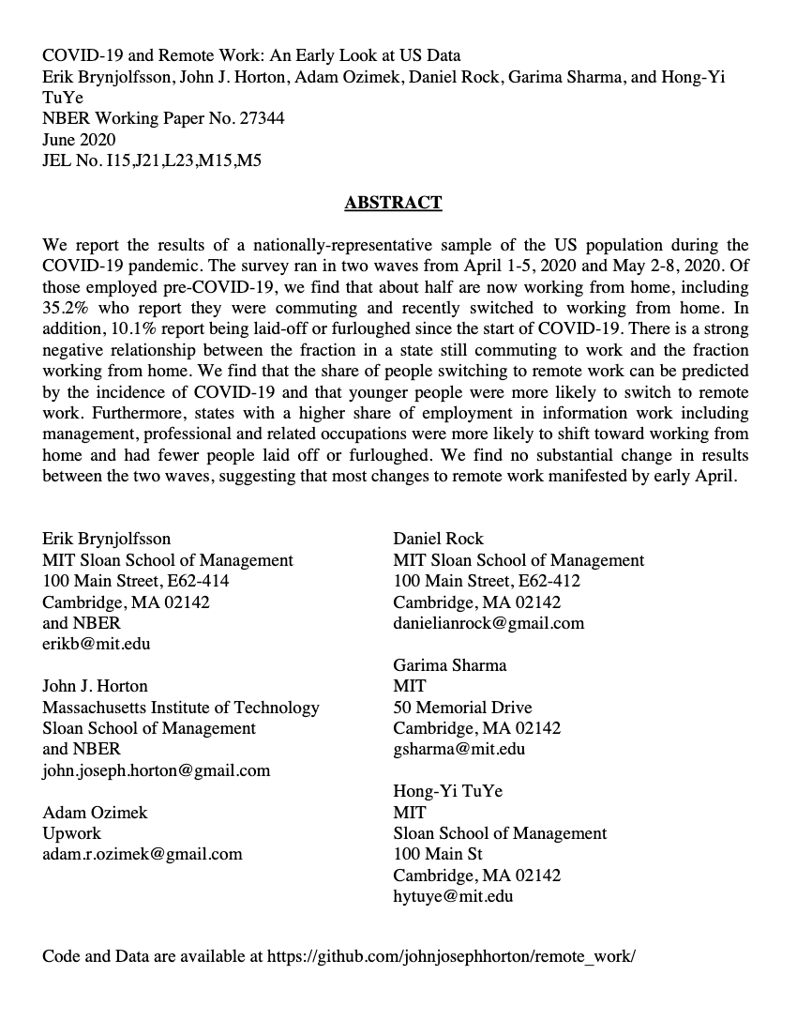
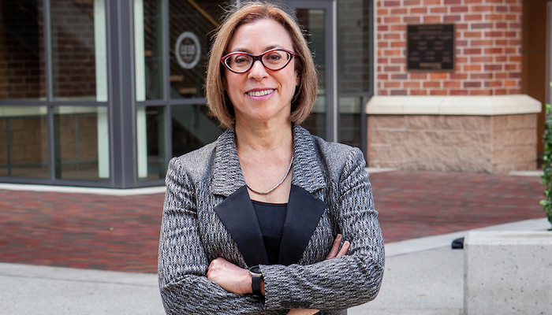
Connecting with research in and outside of MSFT
Prof. Nicholas Bloom
Stanford University
Prof. Gloria Mark
UC Irvine
Centering Microsoft in the global conversation through events
(e.g. aka.ms/nfw2020)
Bringing top research from universities and other companies to product groups
aka.ms/forw-events
Notes:
And we’re also engaging with research outside of MSFT. We’re incorporating it into the syntheses we’re writing. there have been two other talks in this E+D series focused on remote work and in August MSFT hosted a conference on the new future of work.

Slide 10
Future of Remote Work Initiative: Goals
Process:
Coordination of research: Build on each other’s and external work, synthesize results, support and improve each other’s work.
Outcomes:
Thought leadership: Tell a cohesive, rigorous story about remote work and its implications for Microsoft.
Internal impact: Help Microsoft support its employees and community through a time of unprecedented change.
Inform product: Help to deliver new experiences and devices that will allow people and organizations to thrive as work norms evolve.
Notes:
In addition to helping researchers connect and build on each others work, the initiative wants to contribute to MSFT’s thought leadership on remote work, help inform our internal policies and practices and help products and devices build on the research findings.

Slide 11
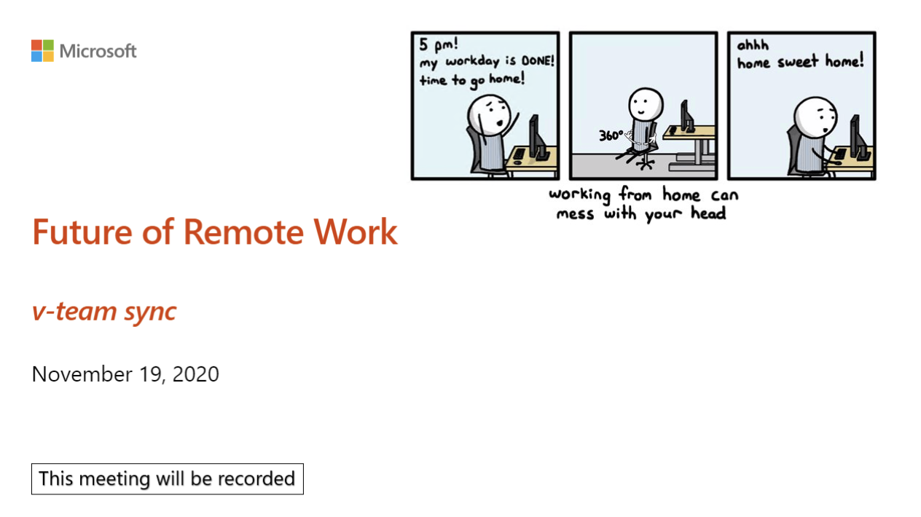
Resources to help you make data-driven decisions about remote (and hybrid) work
Syntheses of hundreds of pages+slides of research output
Data-driven memos on key issues, research papers, FAQ, and more
Community activities (weekly call, Team with ~700 members…)
all available at aka.ms/forw
Notes:
To that end, our website has syntheses that summarize the research findings on six broad research areas. As well as an FAQ and memos/recommendations based on the research. We also have a Teams channel and weekly call where folks share findings and ask questions.

Slide 12
Impact on MSFT and our products
Within MSFT:
Guidelines & learning materials
Practices suggested by research
Products in release:
Virtual Commute
Me Time
Products in the pipeline:
Meeting Coach
Affective Microsoft Teams Presentation Spotlight
WPA Meeting tracking improvements
Microsoft Teams Rooms (Persistent AV spaces for co-work and socialization)
Spatial Sound in Microsoft Teams
Hybrid Meeting Rooms
Notes:
So far, the research findings have been used in the learning materials accompanying the new HR flexible work policy. And practices some orgs have adopted such as starting meetings 5 or 10 min after the hour. A couple product features building on the findings have been announced and many more are in the pipeline.

Slide 13
Initiative leaders
Organizing team
Abi Sellen
Alana Dickson
Brent Hecht
Hadjar Homaei
Jenna Butler
Peter Bergen
Sean Rintel
Sonia Jaffe
Executive sponsor
Jaime Teevan
Advisory board
Emma Williams
Eric Horvitz
Jared Spataro
Kirk Koenigsbauer
Track leaders
Abi Sellen
Adam Coleman
Bill Buxton
Brian Houck
Chandra Maddila
Emily Peloquin
Ginger Hudson
Hana Wolf
Jenna Butler
Kate Nowak
Longqi Yang
Mary Czerwinski
Matt Brodsky
Nancy Baym
Peggy Storey
Rachel Bergmann
Ricardo Reyna Fernandez
Sean Rintel
Shamsi Iqbal
Sid Suri
Sonia Jaffe
Steven Derhammer
Tiffany Smith
Notes:
All this is possible because of the work of the hundreds of initiative members, with particular thanks to everyone who has taken on a leadership role in the initiative.
Now I’m going to turn it over to Alana Dickson who is another one of the organizers and a program manager in M365 insights. She is going to guide us through the research findings.

Slide 14
Research “tracks”
Collaboration and Meetings
2. Personal Productivity and Wellbeing
3. Software Engineering Experiences
4. Physical Ecosystems and Devices
Societal Implications
Our website: aka.ms/forw
Notes:
•Thank you, Sonia. Now we’ve organized this incredible breadth of research that Sonia discussed into research tracks that are critical to understand in this new world of work.
•Each of these tracks has a group of research leaders that regularly update their track pages on our website to reflect the latest findings and engage with product & internal policy teams on their topics.
•So for the rest of today’s presentation, I’ll invite one of the leaders from these 5 tracks to highlight the most powerful research findings in these areas since our last presentation in June.
•Quick note on Q&A- as we go through these slides, make sure to post any questions that you have to the Teams live chat and we will respond there.
•Track 1 intro: So with that, I will hand things off to Sean Rintel from our MSR Cambridge team, who will present on our collaboration track.

Slide 15
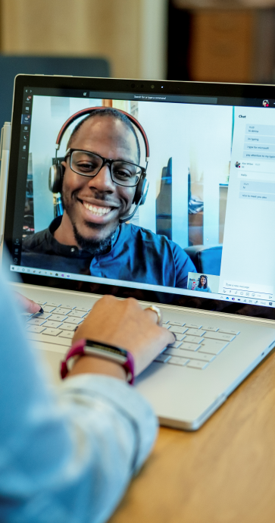
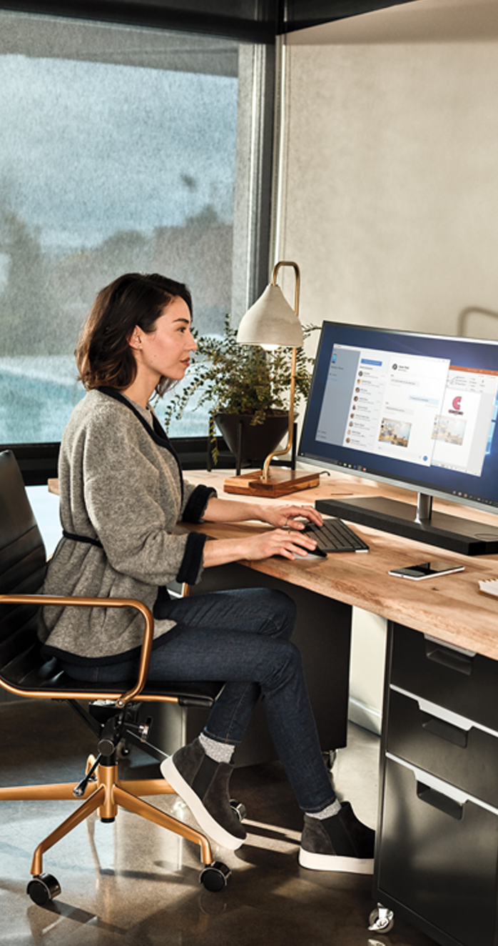
Collaboration and Meetings
Track leaders
Abi Sellen (Deputy Director, MSR Cambridge), Nancy Baym (Senior Principal Researcher, MSR New England), Rachel Bergmann (Research Assistant, MSR New England), Tiffany Smith (Design Researcher, Office Planning and Research), Adam Coleman (Principal Design Researcher, Office Planning and Research), Ricardo Reyna Fernandez (PM, Cambridge), Sean Rintel (Principal Researcher, MSR Cambridge)
Featured studies
Multitasking Behavior During Remote Meetings (Hancheng Cao, Chai-Jung Lee, Shamsi Iqbal, Mary Czerwinski, Priscilla Wong, Sean Rintel, Brent Hecht, Jaime Teevan, Longqi Yang)
Neurodivergent Professionals Working from Home (Maitraye Das, John Tang, Kathryn E. Ringland, and Anne Marie Piper) - MSR
Remote Onboarding of New Software Developers (Paige Rodeghero, Thomas Zimmermann, Brian Houck, Denae Ford) – MSR and Azure
Effects of Remote Work on Collaboration Among Information Workers (Longqi Yang, David Holtz, Sonia Jaffe, Siddharth Suri, Shilpi Sinha, Jeffrey Weston, Connor Joyce, Neha Shah, Kevin Sherman, Brent Hecht, Jaime Teevan)
Meeting Coach and Affective Presentation Spotlight (Samiha Samrose & Prasanth Murali, Mary Czerwinski, Daniel McDuff, Javier Hernandez, Jina Suh, Kael Rowan, Javier Hernandez, Robert Sim, Shamsi Iqbal, Sean Rintel, Robin Moeur​, Piali Choudhury) – MSR
Project Tahiti (Sean Rintel, Abi Sellen, Advait Sarkar, Nancy Baym, Rachel Bergman. Thanks to Priscilla Wong and Emily Peloquin) MSR
aka.ms/forw-collab
Notes:
Track 1 intro: So with that, I will hand things off to Sean Rintel from our MSR Cambridge team, who will present on our collaboration track.
Thankyou.
Today I will be covering four research studies that suggest designing for specific behaviors or populations.
I’ll then cover four research projects that are specifically driving toward product impact.

Slide 16
Thoughtless collaboration will always be poor collaboration, no matter how good technology is.
Have Better Remote And Hybrid Meetings by Being More Intentional from Project Tahiti (Sean Rintel, Abi Sellen, Advait Sarkar, Nancy Baym, Rachel Bergman. Thanks to Priscilla Wong and Emily Peloquin).
Notes:
What ties all these studies and projects together is one of the overall themes from Project Tahiti: intentionality.
Thoughtless collaboration will always be poor collaboration, no matter how good technology is.
You can read Tahiti’s recommendations on having more intentional meetings now, linked at the bottom of this slide.
The projects I discuss today all point to the need for improved mutual shaping of technology and practice.

Slide 17

Designing for multitasking in meetings
Microsoft employees* multitask more as attendee numbers and meeting durations increase, in recurring and scheduled meetings, in the morning, and Monday-Thursday. Employees are polarized over its value and respectfulness.
Practice and technology implications
Consider appropriate meeting times and attendees, allow space for positive multitasking.
Develop a spectrum of engagement for remote meetings from focused to monitoring; help people decide which meetings to attend.
"I find myself multi-tasking in meetings that do not require my attention, but not in meetings that do. In some ways, I may be more productive given the ease of multi-tasking in remote meetings."
Project Tahiti (P508)
*
Telemetry from ~48,000 US Microsoft employees and diaries from 715 global Microsoft employees in Multitasking Behavior During Remote Meetings (Hancheng Cao, Chai-Jung Lee, Shamsi Iqbal, Mary Czerwinski, Priscilla Wong, Sean Rintel, Brent Hecht, Jaime Teevan, Longqi Yang)
Notes:
{blah blah blah}
Instead of trying to decide whether multitasking is positive or negative, we should instead be supporting multitasking as a choice rather than backing people into corners where they feel they have to multitask to get work done or are multitasking in a way that unthinkingly effects others.

Slide 18

Designing meetings for neurodivergent professionals
Neurodivergent professionals* are both implicitly and explicitly negotiating or creating workarounds for engaging in meetings, which takes significant effort.
Practice and technology implications
Manage the complexity of multimodal communication (video, audio, text chat, captioning).
Support predictable and orderly turn-taking.
Integrate access technologies into virtual tools.
Routinize and synchronize agendas, transcripts, recordings, and notes.
“Always part of my attention is about managing my behavior outwardly so that I’m not doing something weird and distracting the other person...there’s some degree of effort in behaving like I’m paying attention instead of paying attention.”
(P21 ASD)
*
Interviews with 36 neurodivergent professionals in Neurodivergent Professionals Working from Home (Maitraye Das, John Tang, Kathryn E. Ringland, and Anne Marie Piper)
Notes:
{blah blah blah}
These needs are very similar to those of all employees. Designing for their intentionality needs will improve experiences for all.

Slide 19
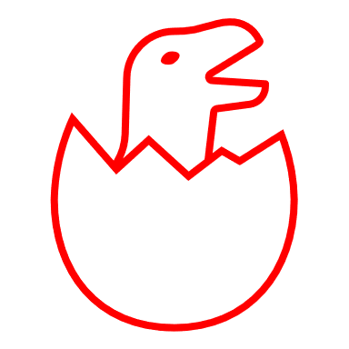
Designing meetings for new joiners
New software developers* experience significant challenges asking for help and building team connections. They are especially affected by the lack of ambient and spontaneous engagement with their team.
Practice implications
Promote communication & asking for help.
Encourage teams to turn cameras on to help develop understanding of personal and team dynamics.
Schedule 1:1 meetings and team social meetings.
Emphasize team building.
“Because everyone is working from home, I don’t run into people randomly or walk by their office, which has led me to ask for less help than I usually would have because I don’t like asking small, half thought-out questions virtually.”
Project Tahiti (P106)
*
Survey of 267 new hires at Microsoft onboarded to development teams during the pandemic in Remote Onboarding of New Software Developers (Paige Rodeghero, Thomas Zimmermann, Brian Houck, Denae Ford)
Notes:
{blah blah blah}
The problems that new joiners’ face because of a lack of ambient engagement are another example of a subset problem that, if solved, would also help existing employees.

Slide 20
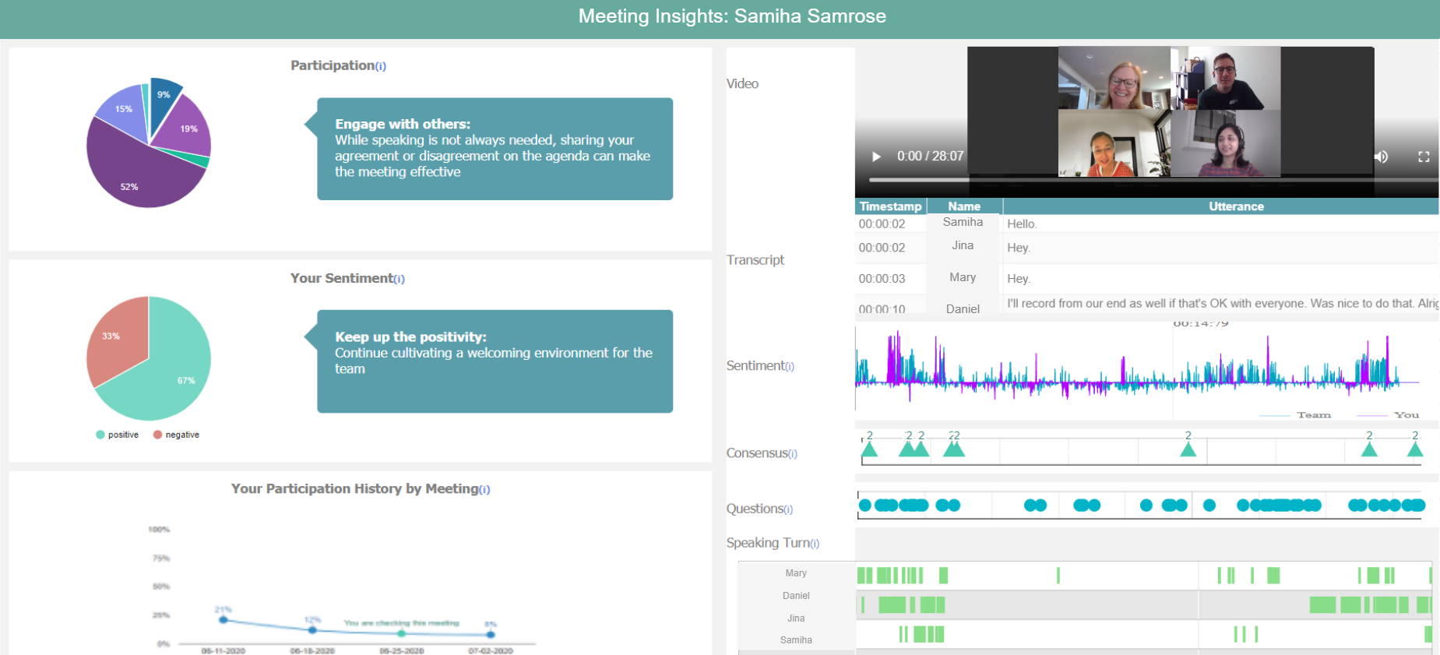
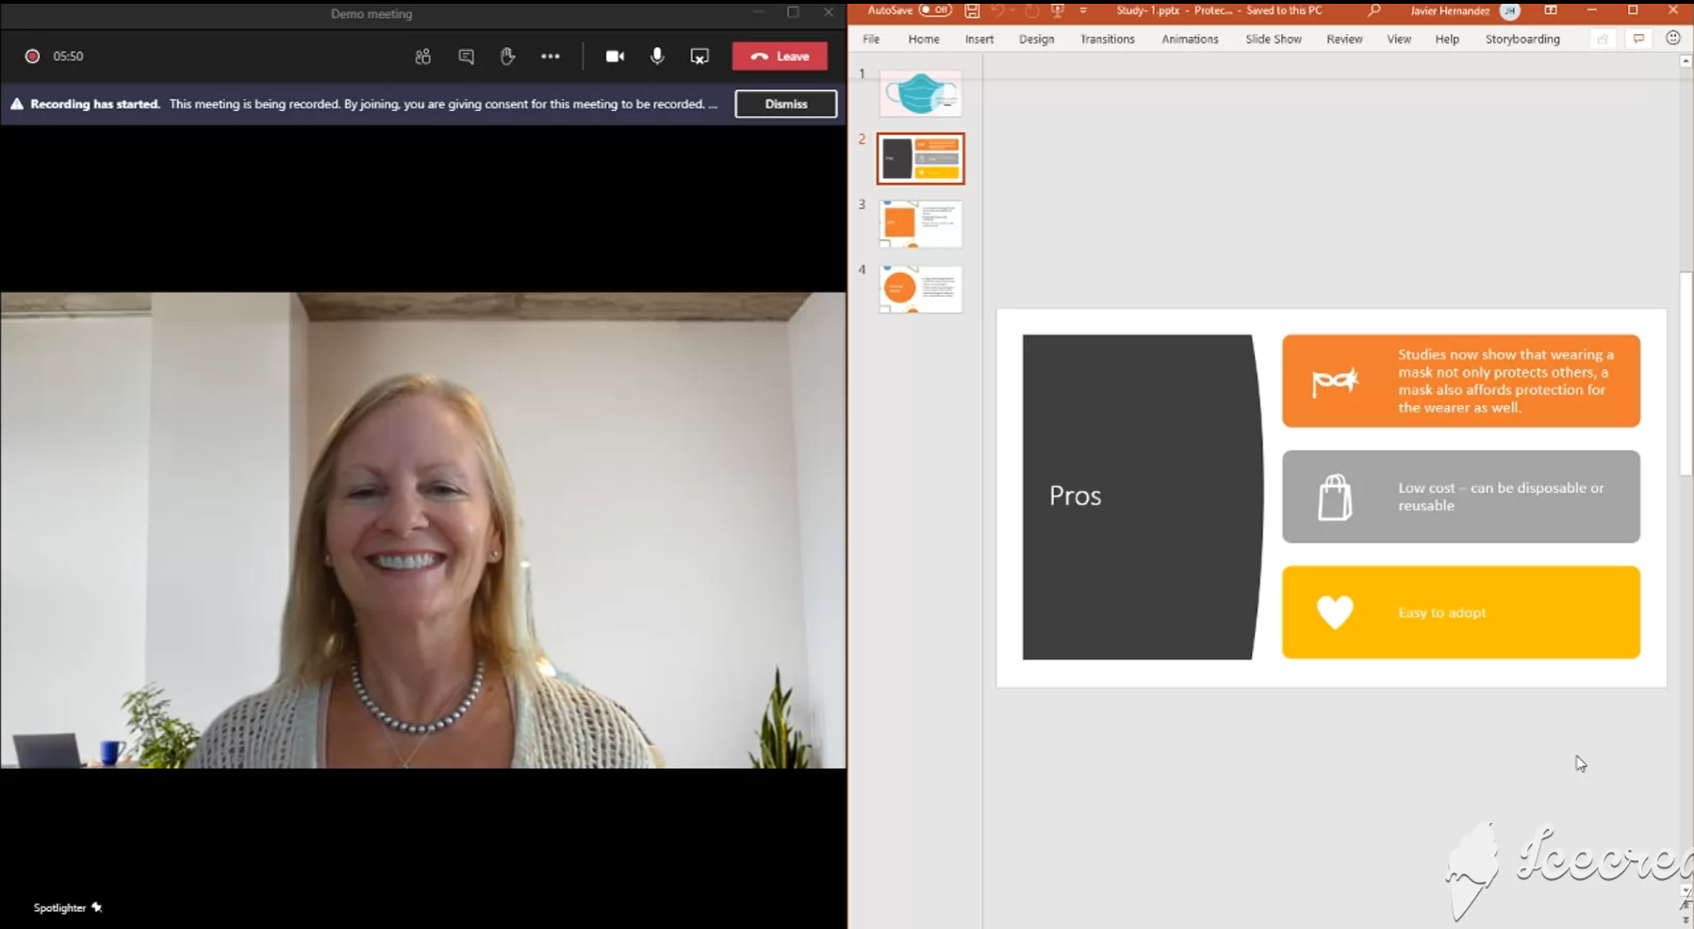
Designing effective and inclusive meetings
While video meetings may make it harder to understand the dynamics of a meeting, machine perception offers opportunities to reflect and rethink engagement.
Meeting Coach:* A post-meeting dashboard can help individuals and groups understand how to act effectively and inclusively.
Affective Presenter Spotlight:* AI can show, with permission, selected audience members rather than the distraction of everyone or the void of no-one.
Both projects are in talks with Microsoft Teams.
*
Survey of 120, studies of 16 and 49 Microsoft employees in Meeting Coach and survey of 175 and study of 114 Microsoft employees in Affective Presentation Spotlight (Samiha Samrose & Prasanth Murali, Mary Czerwinski, Daniel McDuff, Javier Hernandez, Jina Suh, Kael Rowan, Javier Hernandez, Robert Sim, Shamsi Iqbal, Sean Rintel, Robin Moeur​, Piali Choudhury)
Notes:
{blah blah blah}
Mary Czerwinski’s group is in talks with Microsoft Teams. These are excellent examples of research providing advanced features to product groups in the near term.

Slide 21
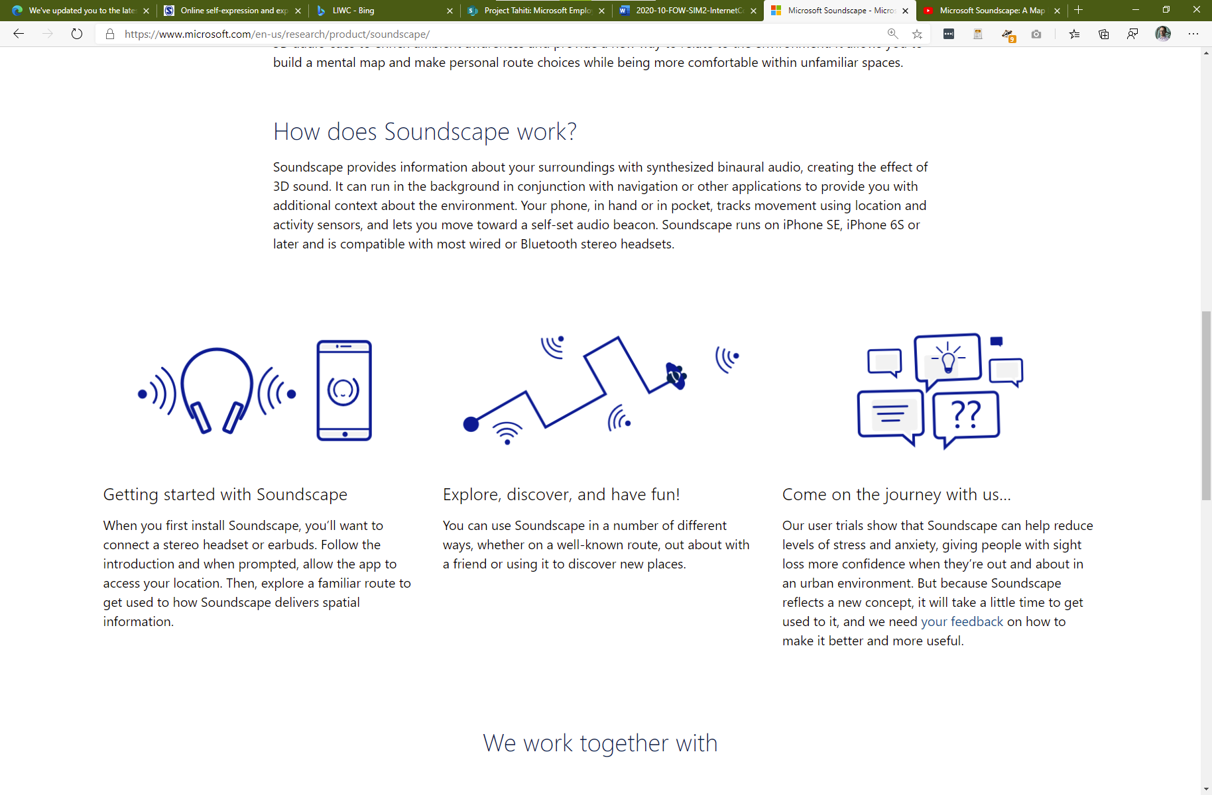


Designing for remote and hybrid futures of work
Remote work
Taking-turns in remote meetings is hard because the soundscape is so flat and unnatural. Spatial Audio in Microsoft Teams* has been initiated to investigate how Microsoft Soundscape’s spatial audio can make meetings more effective and inclusive.
Hybrid work
Hybrid meetings are still profoundly asymmetrical for remote participants. Project Malta* is part of the Future Meeting Room initiative that has been initiated to investigate how to make hybrid meeting engagement symmetrical, scalable, and adaptive.
+
Moving back to Hybrid meetings we must not fall back to those in the room have a larger say in the meeting and those online become second class citizens in the meeting.
Project Tahiti (P097)
*
*
Contact Abigail Sellen or Amos Miller for Spatial Audio in Microsoft Teams
Contact Kori Inkpen for Project Malta
Both projects also draw data from Project Tahiti (Sean Rintel, Abi Sellen, Advait Sarkar, Nancy Baym, Rachel Bergman. Thanks to Priscilla Wong and Emily Peloquin)
Notes:
{blah blah blah}
Preview: Future meeting room initiative THAT GINGER HUDSON WILL DISCUSS LATER
These projects are benefiting from years of research by MSR that are now coming to fruition.

Slide 22
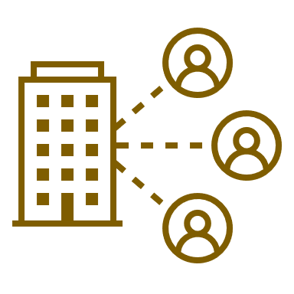
Designing for the effects of remoteness
All-remote work has led Microsoft employees* to have:
less diverse networks and hence fewer new sources of information from outside their team.
fewer scheduled meetings and more unscheduled call hours.
Concerns
The lack of ambient and serendipitous engagement may hinder both team culture and innovation.
“One of the largest problems with mandatory WFH is being unable to talk f2f with other employees who might help in making introductions to their networks. So forming new and maintaining existing relationships requires dedicating a set amount of time to make it possible.”
Project Tahiti (P100)
*
Telemetry from ~50,000 U.S. Microsoft employees in Effects of Remote Work on Collaboration Among Information Workers (Longqi Yang, David Holtz, Sonia Jaffe, Siddharth Suri, Shilpi Sinha, Jeffrey Weston, Connor Joyce, Neha Shah, Kevin Sherman, Brent Hecht, Jaime Teevan)
Notes:
{blah blah blah}
This lack of diverse contacts is linked to the problems of new joiners mentioned earlier, and the final project I describe is now addressing it.

Slide 23
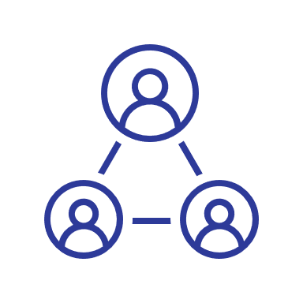
Designing for the fabric of collegiality
The greatest impact of all-remote work during COVID-19 has been social isolation:
missing collegiality in and around meetings
missing collegiality throughout the day
Product impact: Microsoft Teams Rooms* is an investigation into a new persistent ambient AV modality for always on co-working neighborhoods and always-there destinations for socializing.
MVP work will begin in Q1 2021
It is too big of an emotional hurdle to have to request time to talk to someone in a Teams call or a chat. When we were all working in the same space, I could see if someone was available to talk with.
Project Tahiti (P324)
*
The missing fabric of collegiality findings from Project Tahiti (Sean Rintel, Abi Sellen, Advait Sarkar, Nancy Baym, Rachel Bergman. Thanks to Priscilla Wong and Emily Peloquin). Rooms feature being developed with Microsoft Teams CMD (PM: Devikah Bhagwat). Feature name is indicative only.
Notes:
{blah blah blah}
Again, this project will benefit from the input of MSR researchers who are pioneers in Media Space research.

Slide 24
Our collaboration technology should support explanations about why we are collaborating in this way for this purpose
Notes:
Alana transition: Thank you so much Sean. Next, we’ll have Jenna Butler from the OXO team who will present our personal productivity & wellbeing track.

Slide 25

Personal Productivity & Wellbeing
Track leaders
Sonia Jaffe (Senior Research Economist, Office of the Chief Economist), Jenna Butler (Senior Software Engineer, OXO & MSR), Longqi Yang (Senior Data & Applied Scientist), Emily Peloquin (Senior Design Researcher, CSEO), Shamsi Iqbal (Principal Researcher, MSR AI), Mary Czerwinski (Partner Research Manager, MSR AI), Kate Nowak (Senior Program Manager, MWT Insights)
Featured studies
Health, Well-being and Productivity During COVID-19: A Study of Boundaries and Adaptation (Mary Czerwinksi, Shamsi T. Iqbal, Daniel McDuff, Jina Suh, and the HUE Team) - MSR
COSINE Productivity During WFH (Brian Houck)
Product Moxie (Hana Wolf, Leslie Forman, Sunny Patel, Anton Zadorozhnyy, Lindsay Kelly, Amulya Aradhyula) - LinkedIn
Returning to the Office During the COVID-19 Pandemic Recover: Early Indicators from China (Yun Wang, Ying Liu, Weiwei Cui, John Tang, Haidong Zhang, Doug Walston, Dongmei Zhang) – STCA, MSR Asia, MSR Redmond
Project Tahiti (Sean Rintel, Abi Sellen, Priscilla Wong, Nancy Baym, Rachel Bergmann, Emily Peloquin) - MSR, CSEO
Impact of the COVID-19 Pandemic on Remote Work Practices of Neurodiverse Professionals (John Tang, Maitraye Das) - Microsoft Research
CSEO WFH Study (Emily Peloquin, Sheri Panabaker, Emily Downing, Hope Idaewor, Patty Clusserath, Nalini Iyer) - CSEO Studio
aka.ms/forw-personalproductivity
Notes:
Alana transition: Thank you so much Sean. Next, we’ll have Jenna Butler from the OXO team who will present our personal productivity & wellbeing track.
Thank you Alahna. Hi, I'm Jenna Butler and I'm a software engineering in OXO, currently doing a research fellowship with the Productivity and Intelligence team in MSR, and I'm excited to speak to you about the major trends we are seeing in the area of productivity and wellbeing over the last 9 months.

Slide 26

Emerging themes across productivity and wellbeing
Trust
Autonomy
Boundaries
Notes:
Productivity is a complex subject, with entire frameworks devoted to trying to measuring it. One thing we know for sure, is wellbeing and satisfaction are deeply related to productivity. Now that we have 9 months worth of data from studies inside and out, quantitative and qualitative, and numerous interviews to understand the stories behind the data, we are getting a more complete picture of the state of productivity in our current covid world, as well as a glimpse into the post-covid hybrid future. A clear signal is trust, autonomy and boundaries will be key drivers of success in the workplace.

Slide 27
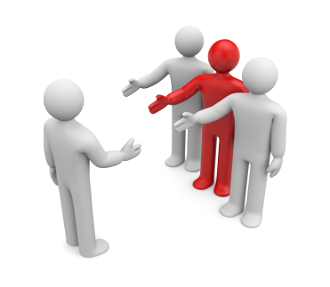

Productivity Impacts Across Roles
Managers
New hires
This Photo by Unknown author is licensed under CC BY-SA-NC.
This Photo by Unknown author is licensed under CC BY-SA-NC.
Trust
Managers must trust teams to avoid increase scope, and individuals must trust their manager to ramp up efficiently
Autonomy
New hires have more flexibility, and ICs have more individual freedom than ever before.
Boundaries
Employees, especially managers, will need to set boundaries for themselves and their team to avoid burnout.
Notes:
Initially when we looked at certain measures of activity, such as PR rates, we didn't see much change as we entered the mandetory wfh period. However, as time went on, we were able to do deeper analysis and split out activity data by role and level. What we found was that managers and new hires seem to be disproportionally affected.
In one large org inside Microsoft managers have had a 300% increase in afterhours instant messaging and a 24% increase in PR rate. When workers went back to the office in China for hybrid work, manager 1:1 time continued to increase as opposed to decrease. It appears managers are both trying to help the emotional needs of their team and picking up additional IC work as reflected in the uptick in manager PRs.
On the other side of the spectrum, new hires in the same org studied were submitting PRs at a rate of 50% of new hires from the year before. Alll of these numbers are deeply concerning. Our managers are necessary for keeping team cohesion and moral high and they are facing burnout. New hires are not getting up to speed as quickly, which could cause discouragement and attrition.
Trust, autonomy and boundaries manifest in this issues but also in the solutions. Managers who lack trust with their team, or perhaps just have new fears since they cannot see what people are doing all day, might be driven to micromanage, which will cause them to be working longer hours and is known to be an inefficient management technique. In addition, new hires who lack trust in themselves, their team or their managers are less likely to ask questions and are potentially more afraid to ask questions in a remote setting where things are surveilled. This means they spend longer trying to figure things out on their own. Suddenly people at every level have more autonomy than ever, with the ability to chose when and where to work. Lastly, boundaries are going to be necessary at every level. Managers can help teams set boundaries, as well as set boundaries around their own work to prevent burnout. This is an area technology could greatly help us and we are already beginning to see this in products coming up.

Slide 28
Surveillance Impact
"Remote work is surveilled work"
A need to "look productive" can be counterproductive
Record of questions asked causes anxiety
Privacy issues in multiple sectors, especially education
Notes:
Another major issue we are seeing is the idea that remote work is surveilled work. This has been coming up in the research since we went home, and actually, has been present in remote work research for years. Concerns in this area impact both productivity and wellbeing. Some people feel nervous to ask questions since there is almost always a record of it, whether an email, chat or recorded teams call. They spend time trying to formulat the question to not sound dumb or to make it the best possible and are blocked longer. In addition, some people worry that the surveillance means they need to always look productive, and ironically, this can be counterproductive in reality. For instance, we understand that an employee might spend hours thinking about a problem without creating a digital trace (such as emails, documents, etc). This could be viewed as "unproductive time" if only measuring activity. However, as information workers, we know this cognitively challening work is one of the main reasons we are doing our job and not computers. Microsoft recently released a productivity score feature to help organizations understand productivity in the remote world, and we knew that could be challenging, especially given that productivity is such a diverse area. Privacy concerns were quickly raised in the media. Microsoft has since applied a growth mindset and adjusted the feature, and we will continue to investigate how we can best enable every person while deeply valuing individual privacy. Lastly, this issue of surveillance is especially concerning in certain sectors like education. As an adjuct professor at Bellevue College, I am seeing colleagues use web cam software to scan the rooms of students before quizzes and exams so they can't cheat – this is concerning. We need to find ways for technology to build trust and allow for remote but safe and private work and education.

Slide 29
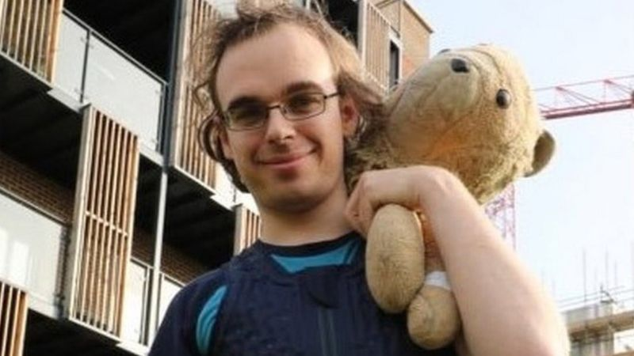
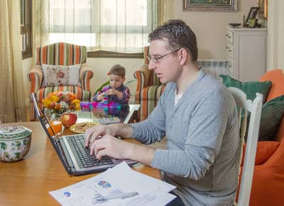
Individual Considerations
Trust
Teams with high levels of trust will assume best intent that individuals are doing what they need to be productive
Autonomy
Individuals will be responsible for making choices about their work environment that best suit them
Boundaries
Some employees may need to leave cameras off or set work hour boundaries for themselves
This Photo by Unknown author is licensed under CC BY-SA.
Notes:
Beyond roles, individual considerations need to be made for how different people work. As Sean discussed, neurodiverse employees may have a hard time working with the webcam on. Some people like to fidget, or have a stuffed animal for physical support, like Jaime here, a developer featured on BBC with his Lion. They may not want this behavior shown during meetings.
In addition, external stimuli has greatly shifted. Where previously the external signals we received were inline with work, now we receive signals about home constantly while trying to stay focused on work. This can be difficult for people who have a hard time focusing. For others, the busyness of the workplace might have been a difficult distraction, and the quiet focus their home office provides has made them more productive. Some people with different mental health diagnoses have found working from home more productive, and have never requested it before either because they didn't realize what a big impact the work environment was having, or they didn't want to disclose their diagnosis.
Again, trust and boundaries can help us deal with the new rules of working. Employees have great autonomy of how they work (do they have a web cam on? Do they work odd hours? Do they exercise while working?) and trust that other people are doing their best will allow people to be their most productive. In addition, setting and respecting boundaries will help people working from home (or anywhere) show up and be comfortable.

Slide 30
Looking to a Hybrid Future
Post-COVID a hybrid model is favored by most employees.
At Microsoft China 69% of respondents preferred a hybrid model compared to purely remote (19%) or traditional office (11%)
More broadly, when surveyed, 63% of MS employees ideally want a hybrid model compared to fully remote (35%) or never remote (3%)
Similar results have been seen at Google
WFH
Hybrid
WFH
Hybrid
Notes:
Of course how we have been working for the last 9 months is working from home during a pandemic, and might not completely resemble our post covid world. As we look ahead, we see from internal data that the vast majority of people ideally want a hybrid work environment. This has also been reported by Google, and other external companies who needed to invest in remote infrastructure to continue working during the pandemic, and are looking at how they can use what they have to potentially enable more remote work in the future.

Slide 31
Emerging Future Issues
Creative and brainstorming work
Team commitment and social connections
Lack of physical and external boundaries
Flexible time
Information exchange
Dual experiences of working from home
Notes:
As we look to this future of hybrid work, what issues do we see? And more importantly, how can these be opportunities for research and product development?
Creative work, new workstreams and brainstorming are harder remotely.
Weak social ties are weakening, but team commitment and social connections are critical for productivity in a remote setting.
31% of workers who feel committed to their team goals prefer working from home over the office, compared with 18% of those who feel disconnected. Could working from home exacerbate a feeling of disconnection from a team? And if so, how can we offset this?
We also now lack physical and external boundaries (like the commute); home problems are present during work times and many feel "always on".
Many people are working different schedules. On one hand, this allows individuals to work when it is best for them, but it can also put indirect pressure for others to work during these hours. How can people work at the best time for them, while maintaining team level productivity?
There is more flexibility for solo work during the day, but we have found focus in isolation can lead to misalignment and the need to redo. How do we keep information flowing to prevent/mitigate this?
Lastly, we continue to see the interesting duality of work from home that Chandra will speak more on. Some people are doing great, others are really struggling. Many people have some parts they love and others they struggle with, often two sides of the same coin. For instance, many Microsoft employees reported appreciating the flexibility of wfh, but struggle with work/life balance because of it. How can we keep the positives and help people manage the challenges? As we've seen throughout, trust and boundaries will help us deal with the new found autonomy of remote work.

Slide 32



Trust, Autonomy and Boundaries
Trust
Build & maintain trust
To mitigate
Autonomy
Technology can help enforce boundaries (e.g. keep meetings on time)
Boundaries need to be set and communicated:
Boundaries
Within teams
Between teams
Among teachers & students
In technology
Micromanaging
Manager overwork
Appearance of productivity
Biased treatment
Lack of information flow
More choice is given to the individuals
Can be positive or negative
Impacts areas like:
Work hours
Exercise
Breaks
Work/life balance
Social interactions
At an individuals level
At a team level, especially around communication
Notes:
Thankfully, Microsoft runs on trust, and we have known tactics to handle these emerging issues. Building trust, within teams, ourselves and especially with our technology will help to mitigate the issues of micromanaging, manager overwork, the desire to appear productive, and more. Having deep trust will allow for more information flow and help people not work in isolation.
In addition, the increased autonomy people how have can be both positive and negative as choice is given to the individual. How do we help people make the most of their new autonomy? How can we empower individuals to work in the way that best suits them, and yet also leads to the most team productivity?
Lastly, we see that boundaries are going to be key factors in success moving forward. Individuals and teams need to set boundaries, and technology can help us enforce these.

Slide 33
Where we are already showing up
Tools for open collaboration: Updates to Teams and Office products are underway to provide more tools for open communication and information flow
Flexibility by default: Research-informed learning materials to help individuals make the most of new HR flexibility
Project Harmony: New research-informed tool to people maintain and generate energy to solve needs around work-life boundaries, distractions, and scheduling and prioritizing time intentionally. Includes a virtual commute and the ability to schedule "me-time"
Notes:
Knowing we have these issues and these avenues of trust and boundaries to help mitigate them, we have already begun creating products that use technology to help.
New features such as virtual commute in project harmony (previously named me time) are helping people set boundaries around the time that is critical for them, and allowing the user to choose what that is – whether its focus time, a lunch break, or exercise time.
We have also started to improve tools, such as Teams and Office, to design them for information flow and asynchonous communcation, something Sean has touched on.
Lastly, HR and Microsoft are using the research to make informed learning materials so people can make the best invidividual choices they can.
As we look ahead, there are still many opportunities in this space. Building tools centered on trust, that allow users to set and maintain boundaries to make their new found autonomy as useful as possible will help us increase productivity and wellbeing in our post covid world.
Alana transition: Thanks so much, Jenna. Next, we’ll move over to talk Software Engineering Experiences, and for that I’ll invite Chandra Maddila who is a Software Development Experiences Senior Research lead, so Chandra please take it away.

Slide 34
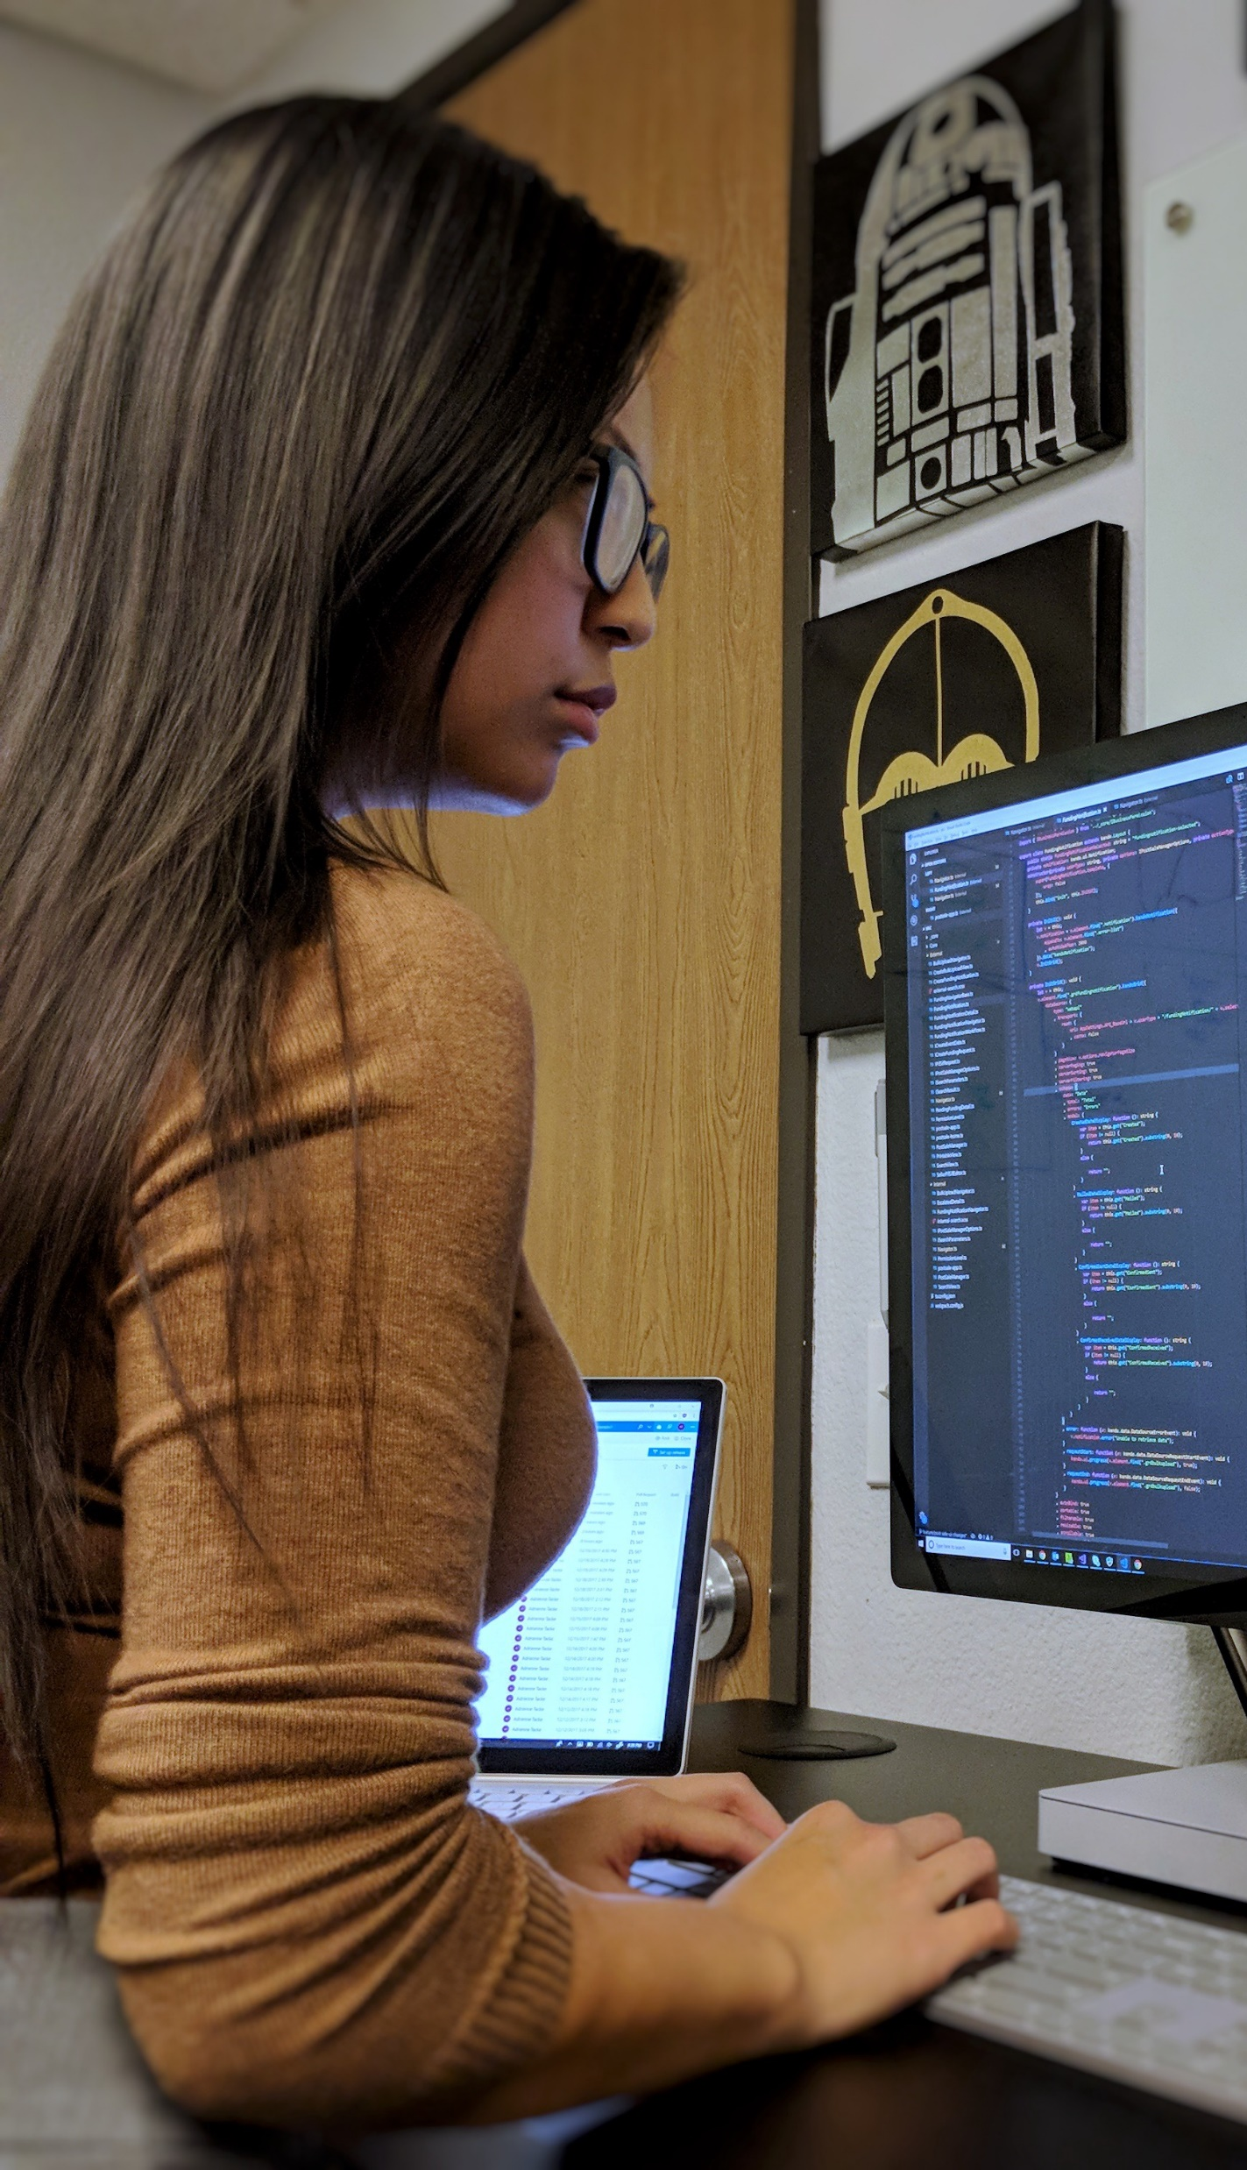
Software Engineering
Track leaders
Chandra Maddila (Microsoft Research) Margaret-Anne Storey (1ES, University of Victoria)
Brian Houck (Azure Edge+Platform)
Featured studies
Developer activity, review activity, geographical distribution (Chandra Maddila, Nachi Nagappan) – MSR
Developer activity, timing of work, and collaboration (Nicole Forsgren, Greg Ceccarelli, Anna Filippova, Taylor Holland, Derek Jedamski, Scot Kelly, Rowan Wing) – GitHub Octoverse Spotlight Team
Tale of two cities (Denae Ford, Margaret-Anne Storey, Tom Zimmermann, Christian Bird, Sonia Jaffe, Chandra Maddila, Jenna Butler, Brian Houck, Nachi Nagappan) – MSR + 1ES + Office of the Chief Economist + OXO + COSINE
Dairy study on developer gratitude and well-being (Jenna Butler, Sonia Jaffe) – OXO + Office of the Chief Economist
Exploring the Effects of Work from Home on Team Productivity (Courtney Miller, Tom Zimmermann – MSR
aka.ms/forw-softwareengineering
Notes:
Alana transition: Thanks so much, Jenna. Next, we’ll move over to talk Software Engineering Experiences, and for that I’ll invite Chandra Maddila who is a Software Development Experiences Senior Research lead, so Chandra please take it away.
While I am representing my own research, I also am going to cover the research and studies conducted by people across the company and GitHub.

Slide 35
What do we cover?
What the data says about engineering output during COVID-19?
What developers say about productivity? The good and bad about WFH.
Where can I learn more?
Ongoing research and projects
Notes:
I will give a glimpse of some of the ongoing projects and research in this area.

Slide 36






Why do we need to understand developer productivity?
Notes:
So, for a tech company like Microsoft (which also has been a primary provider of dev tools for the developers outside), it is important to understand how the developer activity has been which, in a way, gives us a lead to better understand how we are doing as a company.

Slide 37
Measuring developer productivity is not trivial
“Developer productivity is a complex construct which can’t be captured with simple or single metrics like lines of code or issues closed. Developer productivity is a combination of several things, including time spent on code, completing code, and reviewing code” (Meyer et al. 2014).” Can we measure developer activity?
Notes:
The answer is 'yes' we can measure developer activity. Let's see how it is looking like.

Slide 38
Charles Dickens’ “A Tale of Two Cities” begins, “It was the best of times, it was the worst of times.” Adapting Dickens’ line to leading an engineering team during the global pandemic, I’d say “We’re doing very well, we’re barely hanging in there.” — Shane O’Flynn
Notes:
Who is right and who is wrong? What does the data say? Let's find out

Slide 39
Developer activity is up!
PR volume increased by 25% in 2020 (even after accounting for company’s growth)
GitHub
Microsoft
PR volume is showing an upward trend month over month in 2020
Types of PRs: more bug fixes and new features are created
Percentage of code reviews completed is staying consistent
Similar growth in activity is seen in across different geographies
Push volume increased in open source and enterprise GitHub projects
New project creation seen an increase
Workdays are getting stretched (time difference between first and last push)
CloudMine, GitHub Octoverse
Notes:
We see similar activity in open source world through the studies/data analysis that we conducted on open source data.

Slide 40
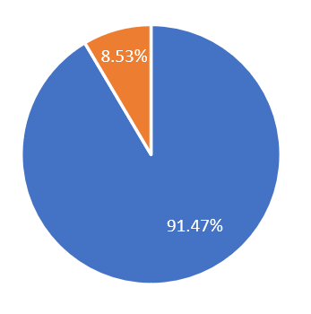
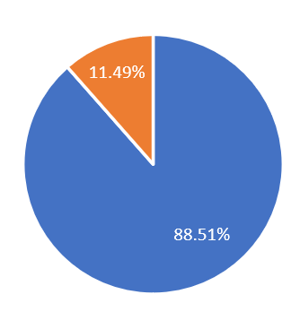
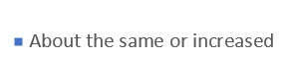
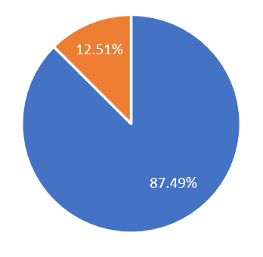
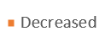
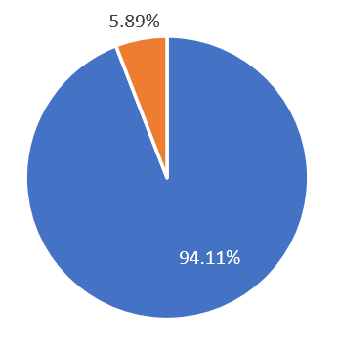
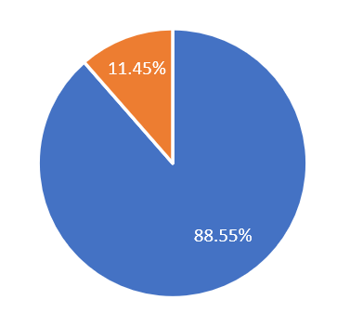
What developers say?
# of PRs that you complete
Velocity of PR completion
Time spent writing code
Time spent reviewing code
Time spent in design activities
Zimmerman et al
Notes:
Developers for the most part says the time they spent on reviewing code and design activities stayed the same or increased in some cases.

Slide 41
It depends!
For most, productivity had not changed or had improved (62% - 68%).
However, many less productive (32% - 38%).
The share of people who said they were less productive decreased over time (38% to 30%), suggesting they, might, found ways to accommodate.
Productivity is individual.
People are affected differently, based on work styles, and the challenges and benefits.
https://arxiv.org/pdf/2008.11147.pdf
Notes:
Productivity is individual. It varies from person to person based on the work style, life style, the circumstances, challenges and benefits. Let's take a look at some of the challenges and benefits that developers see about working from home

Slide 42
The good about WFH
Less time on commute
Spending less money
Flexible work hours
Closer to family
More comfortable clothing
Reduced health risks
Better focus time
Less distractions or interruption
More time to complete work
More breaks
Better work life balance
Better work environment (physical environment)
More efficient meetings
More control over work
More physical activity
https://arxiv.org/pdf/2008.11147.pdf
Notes:
Developers like the fact the they need not to spend so much time on commute, they get better focus time and less prone to distractions and interruptions.

Slide 43
The bad about WFH
Missing social interactions
Lack of work-life boundary
Poor ergonomics
Less awareness of colleagues’ work
Less physical activity
Difficulty in communication with colleagues
Insufficient hardware
Connectivity problems
Poor work life balance
Too many meetings
More distractions and interruptions
Lack of routine
Fewer breaks
Friction with collaboration tools
Lack of motivation
Blocked waiting on others
Poor work environment at home
Lack of dining options
Lack of childcare
Less time to complete work
https://arxiv.org/pdf/2008.11147.pdf
Notes:
Having more distractions or interruptions or lack of motivation or child care are some of the factors that makes developers hate WFH

Slide 44
Productivity is personal.
Clearly, what is working for someone might not be working for others. This is a clear manifestation of ‘Dickensian dichotomy’ – “The best of times, the worst of times!”
Notes:
Clearly, what is working for someone is not definitely working for others. This is what I call ' a manifestation of Dickensian dichotomy'

Slide 45
Team productivity - Challenges
Social connection and communication were the most cited team culture factors
Lack of ability to brainstorm with colleagues
Having less awareness of what colleagues are working on
Having difficulty communicating with colleagues
Satisfaction with social interaction from social activities
Miller, Zimmermann et al.
Notes:
The satisfaction developers attain because of the social interaction and activities came up on top of the list when asked about the factors that is impacting team productivity as a whole.

Slide 46
Ongoing work
Framework for measuring developer productivity.
Large scale analysis on 14,000 popular open-source projects.
Collaboration with Productivity Insights (Azure) team.
GitHub Octoverse Spotlight analysis for 12-month period.
Notes:
We are working towards publishing an update of the GitHub Octoverse blog which we published couple of months back.

Slide 47
Learn more!
aka.ms/DeveloperActivityReport
aka.ms/Octoverse-1
aka.ms/TaleofTwoCitiesCovid
Notes:
I will also post these links in the chat window.

Slide 48
Summary
What the data shows: we’re doing more, longer.
What people tell us: it’s a mixed bag.
Resilience and burnout.
Ongoing research.
Notes:
There is a lot of interesting research going on in this space Please feel free to reach out in case you have any ideas or want to share learning or collaborate. Thanks and back to you Alana.
Alana transition: Thank you, Chandra. Next, we’re going to move on to physical workspaces, and for that I’m going to invite Ginger Hudson, who is a User Research Lead in Devices, so Ginger with that I’ll hand it over to you.

Slide 49
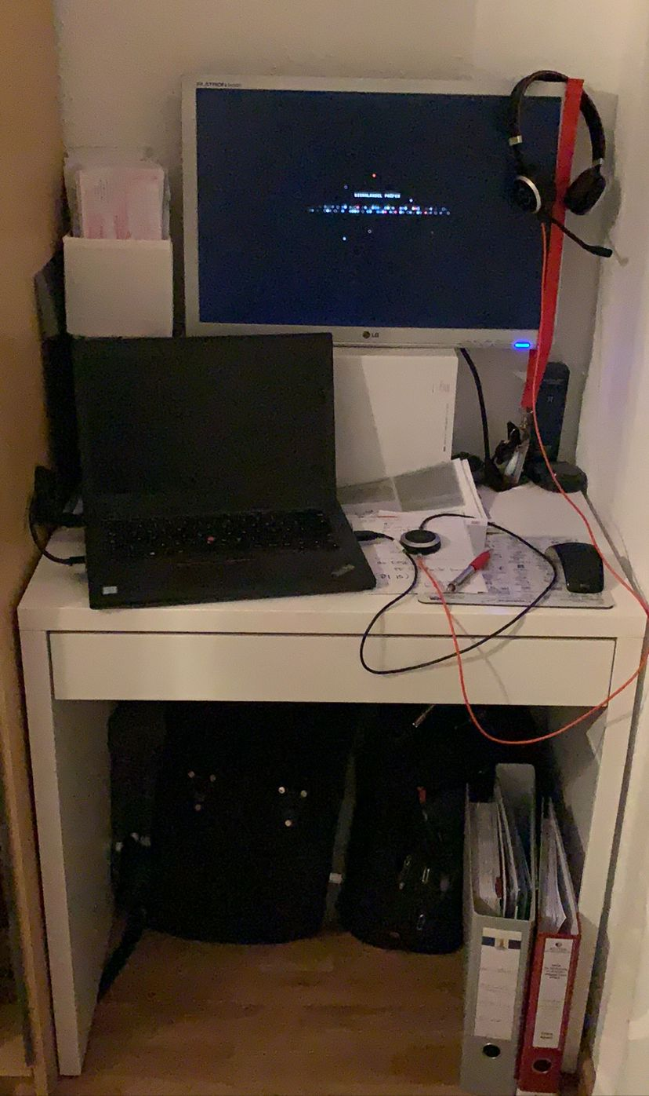
Physical Ecosystems & Devices
Track leaders
Ginger Hudson (Principal User Experience Researcher, Devices)
Bill Buxton (Partner Researcher, MSR)
Steven Derhammer (Senior User Experience Researcher, Devices)
Featured studies
Impact on IW Experience (Productivity/Collab) (Meghan Stockdale, Therese Okraku, Megan Brown, Jamie Miller, Bella Chiu, Shelly Marston) – eXperience Collective Planning & Research
Devices at Home Survey (Teddy Seyed, Nathalie Henry Riche, Ken Hinckley, Bill Buxton, Jonathan Goldstein, Michel Pahud, Nicolai Marquardt, Molly Nicholas, Christian Holz, Hugo Romat, Rojin Vishkaie) – MSR
How You Look is Not Necessarily How You Are Seen (Bill Buxton, Ginger Hudson, Tiffany Smith) – MSR, W&D Devices Research, XC Planning & Research
Device Accessory Needs when WFH (Shuling Chen, Eric Lovelin) – PCA/MACH
Devices + Remote Work Study (Ginger Hudson, Steven Derhammer) – W&D Devices Research
Working across devices is the new normal_Implications for the Office Hub (Therese Kennelly Okraku, Sonal Srivastava, and Madeleine Schulz) – eXperience Collective Planning & Research
aka.ms/forw-devices
Notes:
Alana transition: Thank you, Chandra. Next, we’re going to move on to physical workspaces, and for that I’m going to invite Ginger Hudson, who is a User Research Lead in Devices, so Ginger with that I’ll hand it over to you.

Slide 50
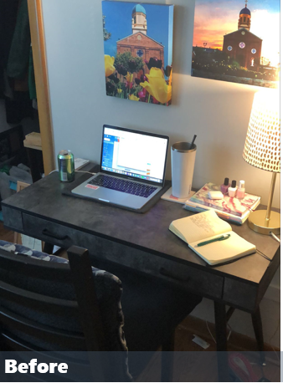
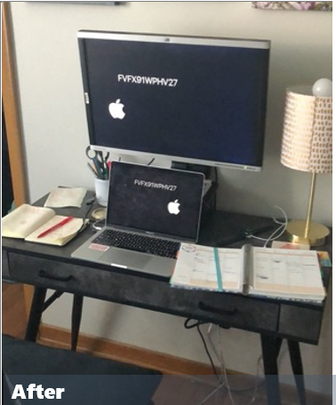
Home workstations have evolved since initial WFH mandates, but only modestly
The majority of IWs have made minimal to moderate modifications to their workstations overall since initial lockdowns.
Most employers allowed IWs to bring items home with them from the office but have not provided a stipend for purchasing additional items for WFH.
“I really don't want to spend money on making it more comfortable and I knew it wasn't going to be forever . . . I really have no idea if they will let me continue [to WFH] when things open up.”
Notes:
Transition language: And some reported that they’ve gotten used to their set-ups despite being non-ideal (compared to what they had in the office) and have been surprised at how they’ve been able to remain productive with less.

Slide 51
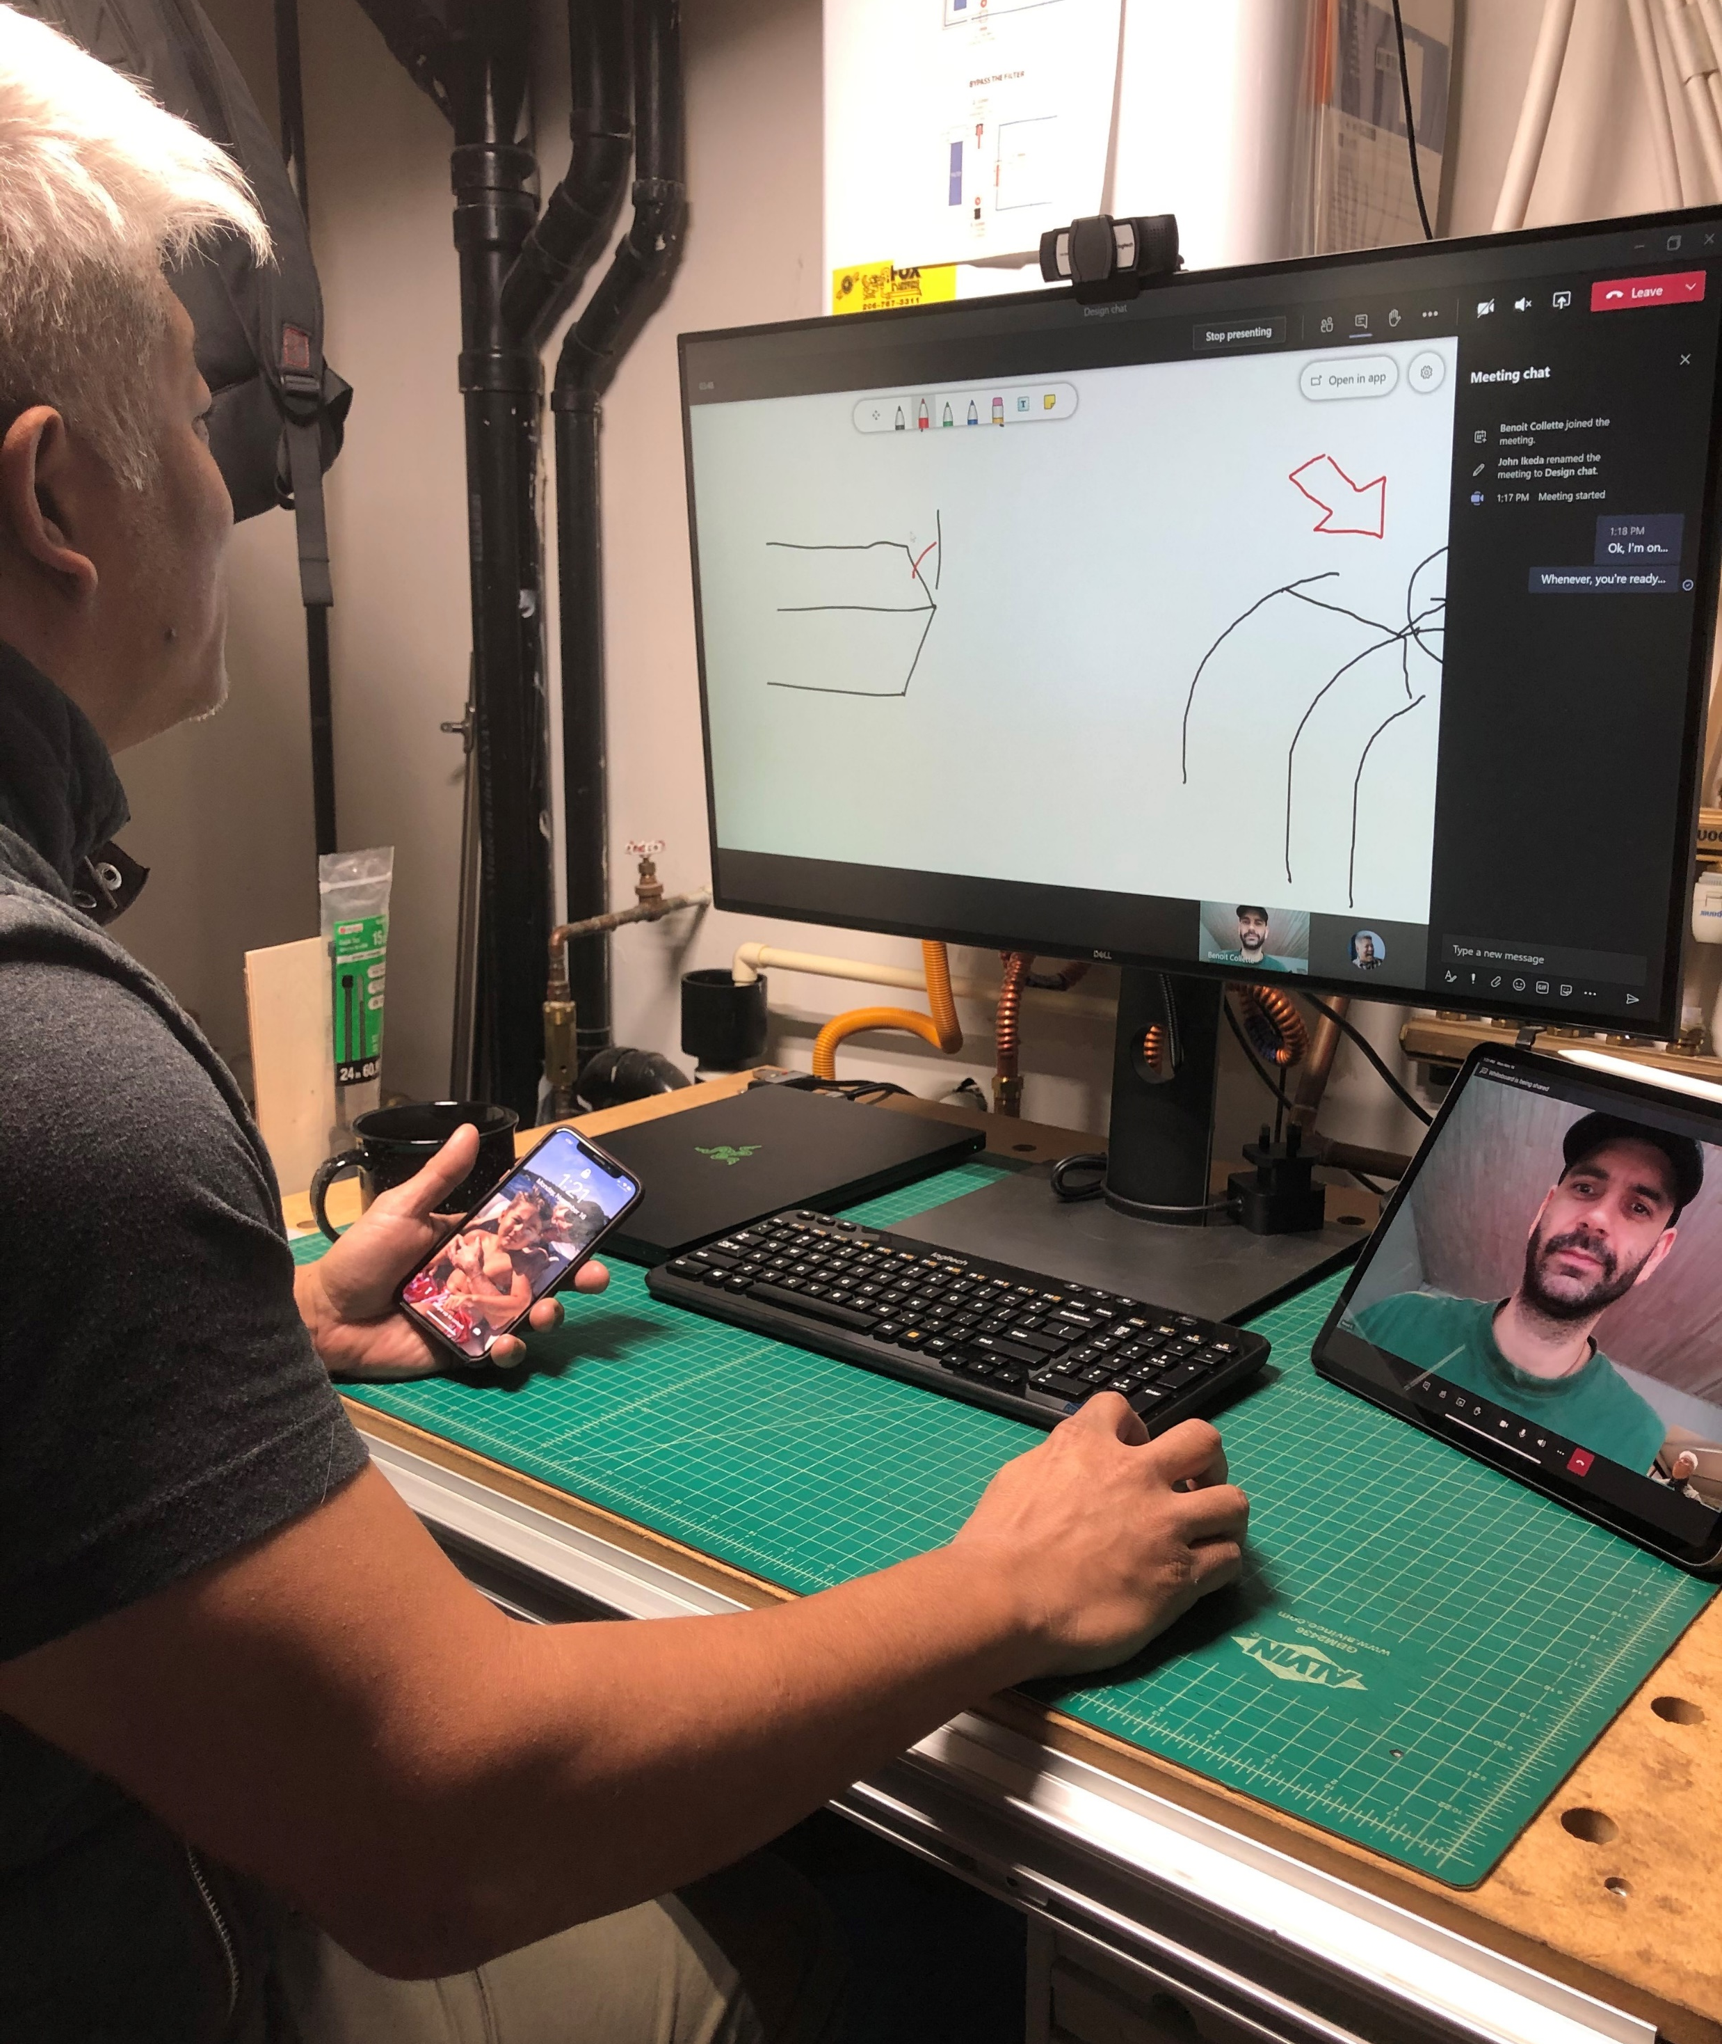
New device behaviors have emerged as people have adapted to working remotely
IWs are using multiple devices (PC, tablet, phone) at the same time to multi-task, be more flexible in location, and provide access to more screens for accomplishing work.
A primary driver of multiple device usage is the desire to multi-task and add screen real-estate during online meetings.
The experience of moving between devices is currently not optimized and there are expressed tension points.
“Working on two devices acts as a secondary monitor in a way. If I am working on a presentation on my laptop or desktop, I don’t have to interrupt what I am working on with a Zoom call since I can use my smartphone for Zoom calls.”
Notes:
Transition language: These are user frustrations, but also this presents exciting opportunities for us to design experiences that work across all devices and different screen sizes.

Slide 52
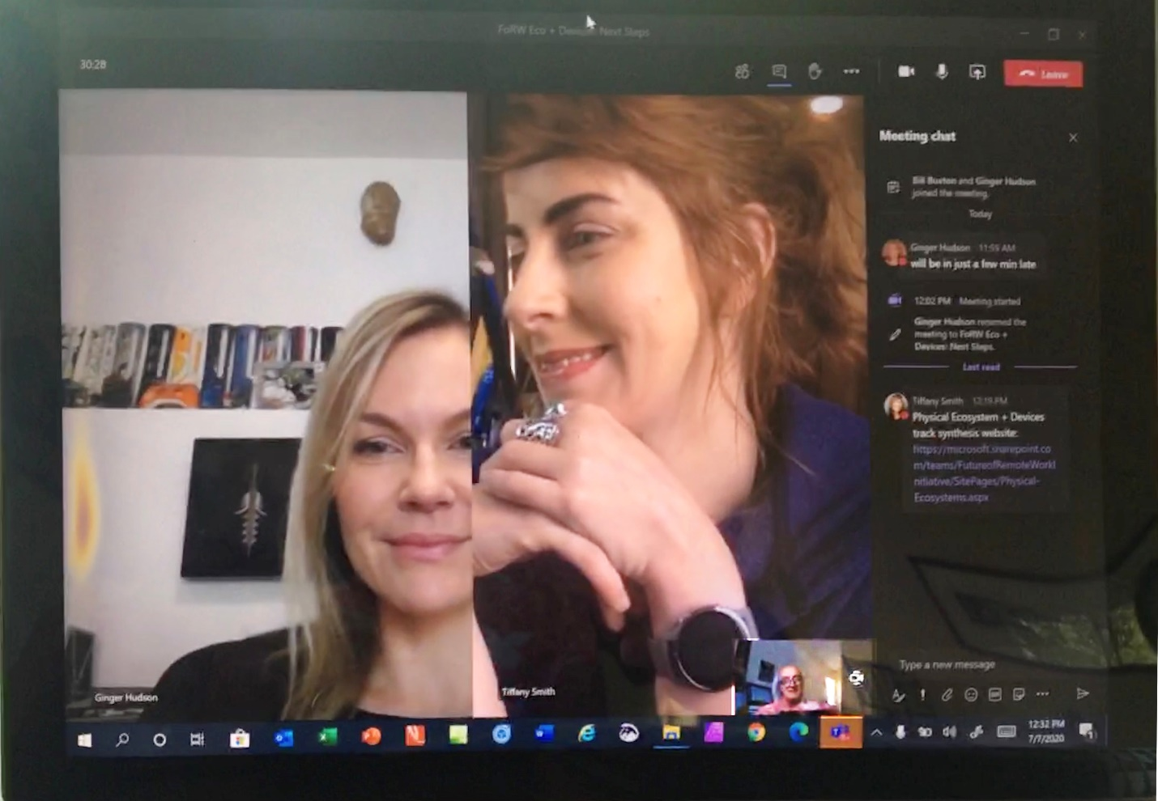
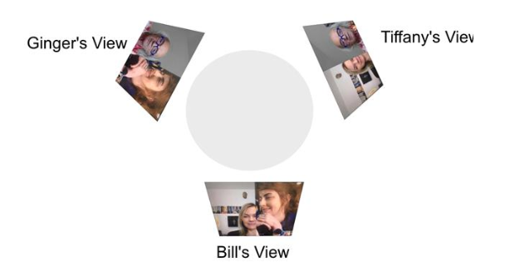
Current equipment and home workstation configurations limit our ability to authentically connect with others
Due to diverse workstation set-ups involving different devices, peripherals, and our SW tool limitations, achieving the desired audio and video experience is challenging.
Online meetings today lack the naturalness and authenticity of in-person interaction, which can be largely affected by:
Gesture awareness
Gaze awareness
Eye contact
Audio quality
Noise interference
3 person Teams interaction with everyone seeing different views. This breaks our mental model of interpersonal interaction.
Notes:
Transition language: . . . none of us on our three person Teams call looked as it we were making eye contact and all of us had wildly different views compared to how we thought we were being seen on video.

Slide 53
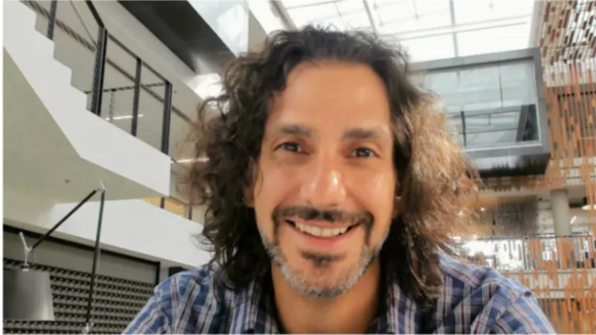
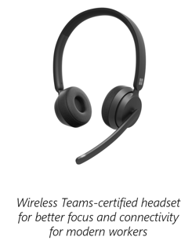
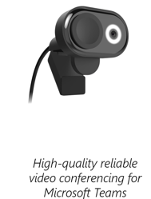
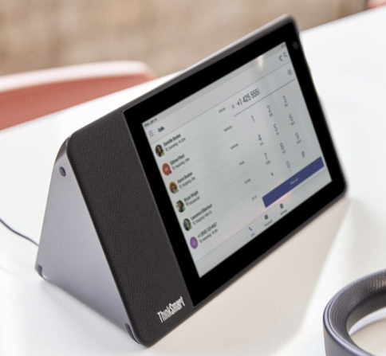
Looking forward
Initiatives addressing Remote and Hybrid work:
ASG is working on new camera technology, including AI processing inside the camera and has released the Eye Contact feature for Surface Pro X
Future Meeting Room initiative
Teams Hardware – Kingston and Teams features like Together mode and break out rooms
A range of Teams certified accessories in development by our PC Accessories team
Steven Bathiche (ASG) demoing the new Eye contact feature
Wireless Teams-certified headset for better focus and connectivity for modern workers
High-quality reliable video conferencing for Microsoft Teams
Lenovo ThinkSmart personal device for Teams
Notes:
Transition language: Lots of exciting innovations happening! And with that I’ll turn it back over to Alana.
Alana transition: Thank you, Ginger. And now we’re going to move on to our last track before we close out, societal implications. For that, I’m going to invite Siddharth Suri, so Sid, please take it away.

Slide 54

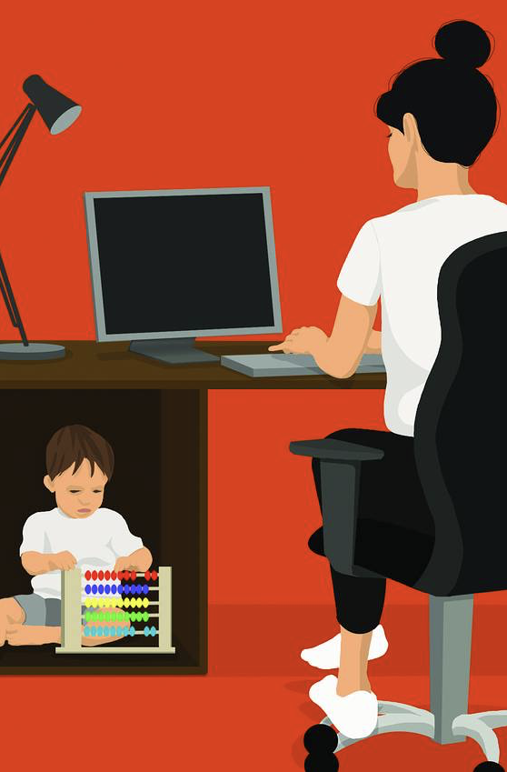
Societal Implications
Track leaders
Hana Wolf (Principal Researcher, LinkedIn UER)
Siddharth Suri (Sr. Principal Researcher, MSR)
Featured studies
Health, Well-being and Productivity During COVID-19: A Study of Boundaries and Adaptation (Mary Czerwinksi, Shamsi T. Iqbal, Daniel McDuff, Jina Suh, and the HUE Team) - MSR
Project Tahiti (Sean Rintel, Abi Sellen, Priscilla Wong, Nancy Baym, Rachel Bergmann, Emily Peloquin) - MSR, CSEO
Effects of Remote Work on Collaboration Among Information Workers (Longqi Yang, David Holtz, Sonia Jaffe, Siddharth Suri, Shilpi Sinha, Jeffrey Weston, Connor Joyce, Neha Shah, Kevin Sherman, Brent Hecht, Jaime Teevan)
aka.ms/forw-societalimplications
Notes:
Alana transition: Thank you, Ginger. And now we’re going to move on to our last track before we close out, societal implications. For that, I’m going to invite Siddharth Suri, so Sid, please take it away.
Next slide after I say MSR or Microsoft Research

Slide 55
Who can work from home?
330M Americans
160M Employed
WFH can exacerbate these inequalities.
How do we empower those who can and cannot wfh?
What is our responsibility to those who cannot wfh?
~½
~½
Can WFH
Cannot WFH
More likely
White
Top half of income
Employer health insurance
More likely
People of Color
Bottom half of income
Not have employer
health insurance
Sources: BLS,
Mongey & Weinberg 2020,
Barrero et al 2020,
Brynjolfsson et al 2020
Notes:
Hit next when I say “about half can work from home and about half cannot work from home”
Hit next when I say “do NOT have employer provided health insurance”
Hit next when I say “gender”

Slide 56
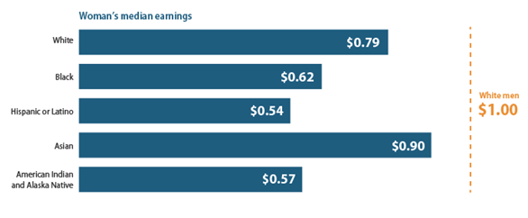
Those with caregiving responsibilities - especially women – are struggling the most
Survey of 200 information workers across the industry
Females with caregiving responsibilities reported:
Difficultly in working productively
More stress and anxiety
Interleaving work and personal life
Sources: Shamsi Iqbal et al, CAP
Notes:
Hit next after I say “long term effect”
People with childcare responsibilities commented on exhaustion, the need to work around the clock to catch up and challenges in homeschooling children, they are eating less healthily than before and exercising less.

Slide 57
Losing between group relationships could decrease innovation
46% of the Microsoft employees surveyed reported their relationships with those outside their team are getting weaker whereas only 24% said they were getting stronger.
Workplace Analytics data showed that working from home caused employees to build and maintain fewer relationships outside of their own business group.
Team 1
Team 2
Team 1
Team 2
Team 3
Team 3
Sources: Project Tahiti, Yang et al
Notes:
Hit next after I say a sentence about innovation occurring when two teams with different information come together or when I say “In conclusion”

Slide 58
Conclusion
Working from home will exacerbate inequalities already present in society.
The full effects of working from home will take years to see.
Justifies Microsoft’s slow and steady approach to adopting working from home.
Notes:
Hit next after I say “This is something we’re doing right and I’d love to see us continue to do this right”
Alana transition: Thank you, Sid, and thank you to all of our speakers. This concludes the research findings part of our presentation, and I’ll wrap up our time together by covering next steps and how you can get involved.

Slide 59
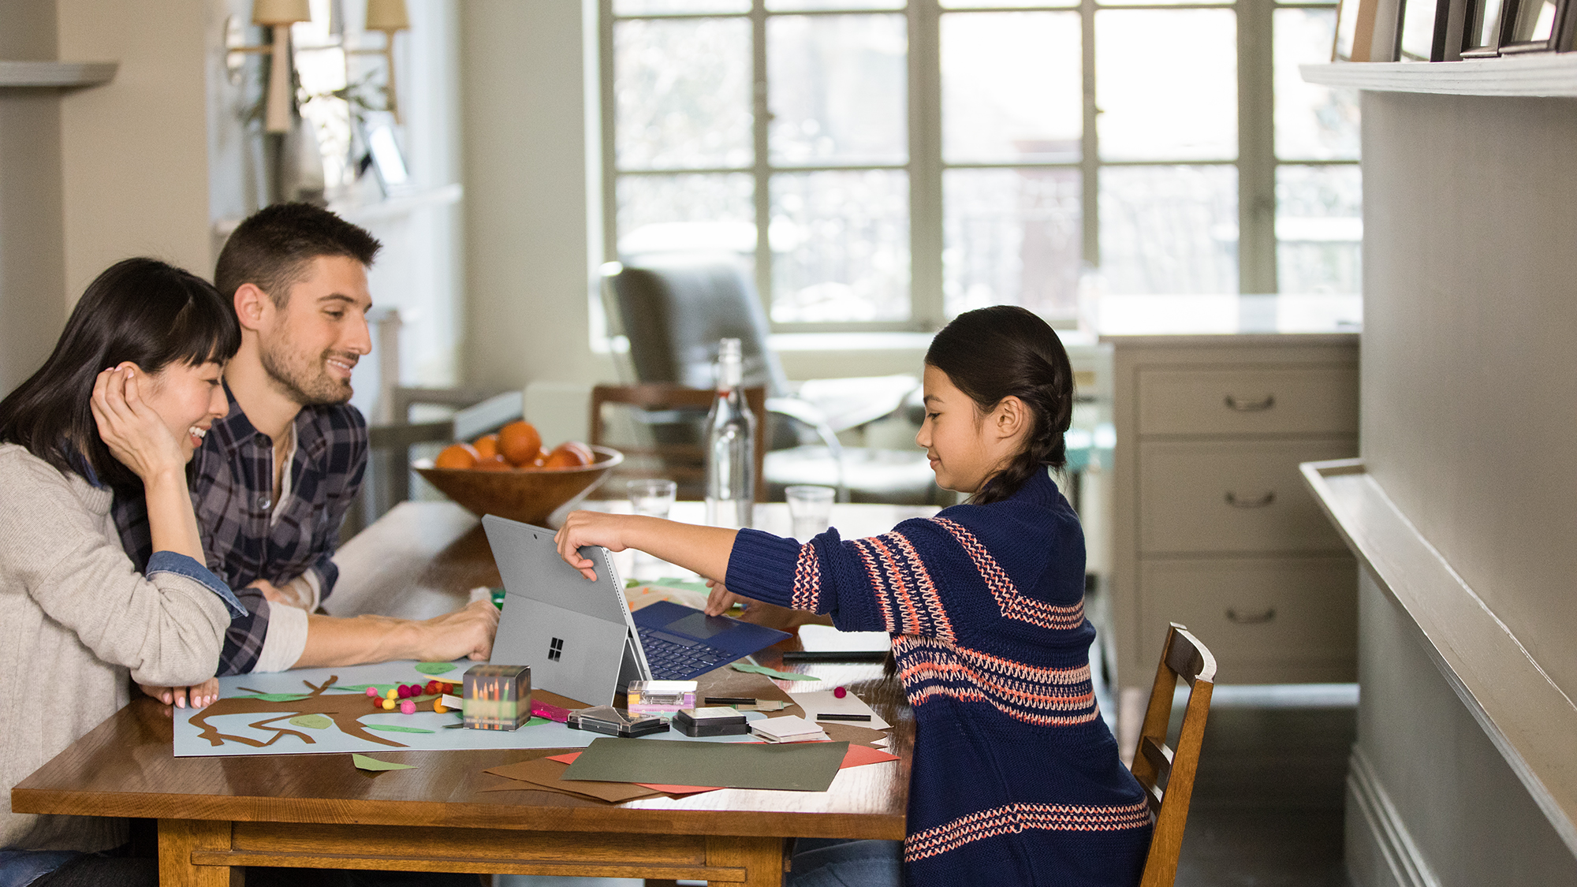
Next steps + how to engage
Notes:
Thank you, Sid, and thank you to all of our speakers. This concludes the research findings part of our presentation, and I’ll wrap up our time together by covering next steps and how you can get involved.

Slide 60
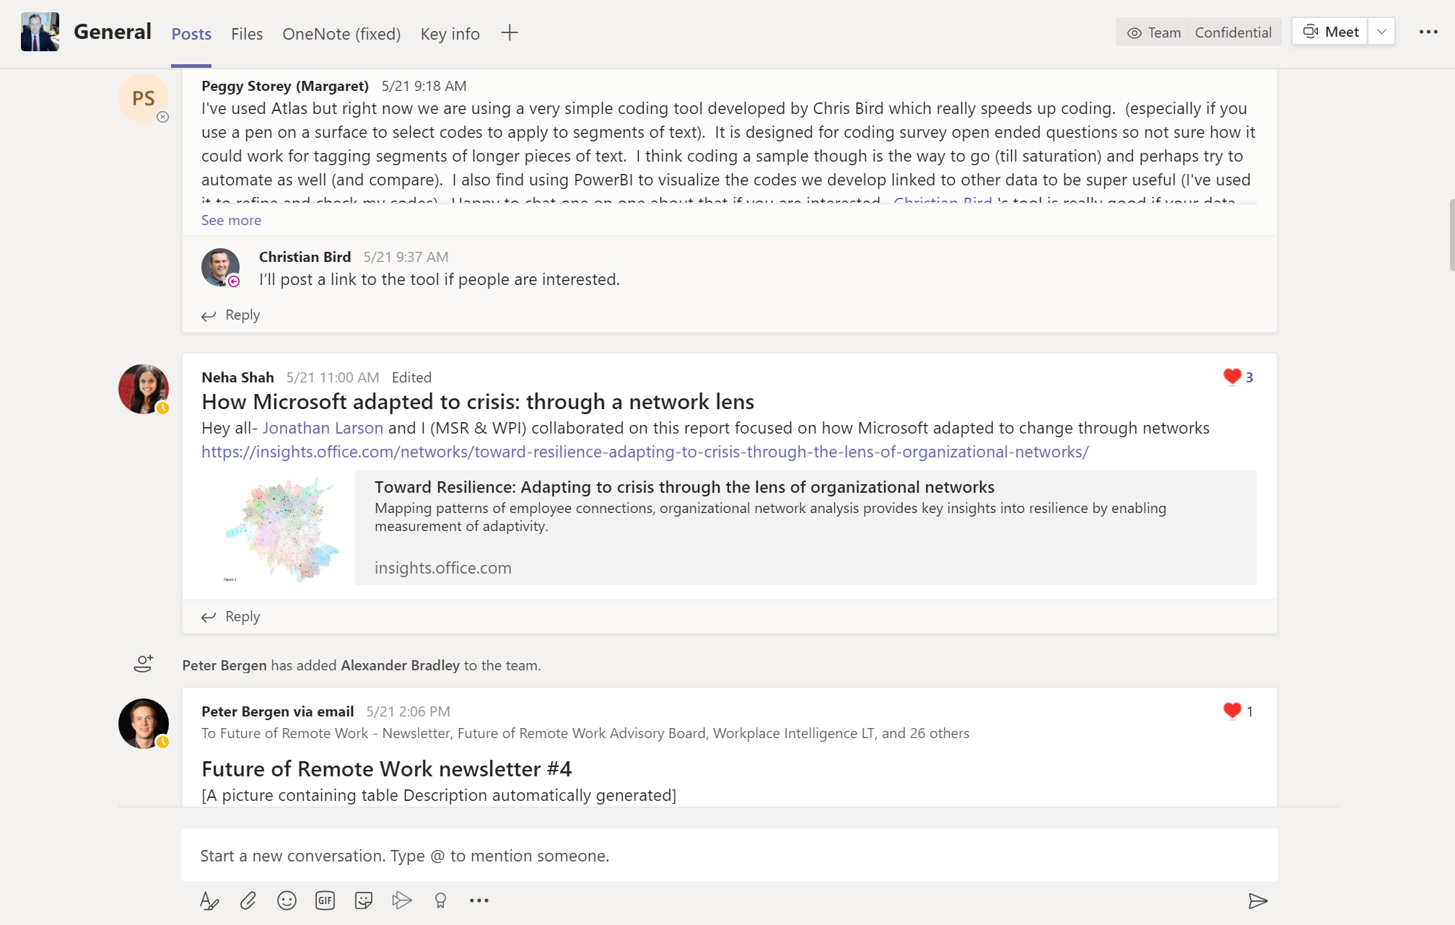
Send us your research and join the conversation
Contact Alana Dickson (aldickso) and Sonia Jaffe (sojaffe) if you’re running a study or know of one that’s not yet represented in this initiative
The conversation on Teams is open to all!
aka.ms/forw-team
Notes:
First, if you have a study or know of a study that’s not represented in the initiative, please reach out to us and we will include it. And for anyone on the call, please join our Teams channel to join conversation around remote & hybrid work related topics.

Slide 61
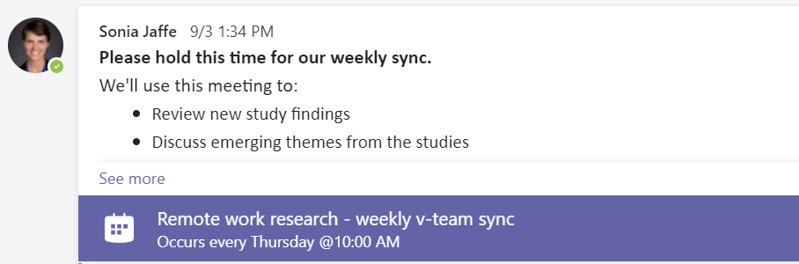
Sign up for our newsletter & join our weekly calls
aka.ms/forw-join
Thursdays @ 10AM PT
aka.ms/forw-team
Notes:
Two great ways to stay up to date on recent findings are to join our regular newsletter, and our regular weekly calls. The next one is next Thursday, December 10th at 10AM.

Slide 62
JEM Event: Future of Work
March 3-5
How we can use what we have learned over the past year to help our customers thrive in a future with much more hybrid and remote work?
What does the research tell us about the unique challenges and opportunities presented by working from home – for individual productivity, team collaboration, social capital, well-being, and more?
What are the different teams at Microsoft doing to help customers overcome these challenges?
What more should we do in the coming months and years to prepare for this new future of work?
aka.ms/JEMevents
Notes:
And we do have a larger upcoming event in March, this is a Joint E&D and Microsoft research event that marks one year since pandemic-induced work from home. The event will focus on how we can use what we’ve learned to help our customers thrive in a world with much more remote work.

Slide 63
Thanks!
Resources and follow-ups:
Future of Remote Work Initiative main website: aka.ms/forw
Read our syntheses: aka.ms/forw-syntheses
Sign up for the newsletter: aka.ms/forw-join
Join our Team: aka.ms/forw-team
Learn about our initiative’s events: aka.ms/forw-events
Connect your project with the initiative: contact Alana Dickson [aldickso] or Sonia Jaffe (sojaffe)
Notes:
And finally, here’s a summary of the various ways to stay involved with the Future of Remote Work initiative. Please be sure to bookmark these links and of course reach out to me or Sonia if you have any questions. In conclusion, I want to say thank you to entire synthesis and organizational team, all contributing studies, and thank you all for attending. We’ll see you next time.

Slide 64
Appendix – Project Decks

